Slide 1

Evangelism made easy for
everyone
Notes:
Welcome to ‘Casting Your Nets’
Leaders Notes –
Casting Your Nets is an initiative between Outreach UK, Good News Newspaper and Pocket Testament League – to enable every Christian to share their faith in Jesus Christ.
You may already be doing that – in which case we pray that this course will encourage, inspire and perhaps, hone your gifts.
Alternatively, you may be coming to this course because you know you should be sharing about your faith in Jesus Christ, but, for some reason, find that impossible or difficult. This course will help you to have more confidence and will show you that, whoever you are, God can and wants to use you to speak about Him.
Each session is both theory and practical – so we encourage you to try putting into practice what you’ve learnt between sessions – and then share about your experiences when you next meet together.
Remember, we are not all the same. We are not all extroverts, or introverts, but we are all brothers and sister in Christ. Encourage and support each other – and grow in knowing Jesus and sharing about Him.
The Leader (this is very important!) –
Prepare by going through each session beforehand.
Make sure the PowerPoint will play on the equipment you have available.
Have your Outreach UK Evangelism Handbook with you.
Copy the relevant pages from the PDF copy of the Outreach UK Evangelism Handbook so that they are available for each participant – I suggest you give these out at the end of each session.
Each participant will need –
A Bible
A notebook
A pen/pencil
And - be ready to participate.
– but don’t force those who are shy, but encourage each one to see they have something to contribute.

Slide 2



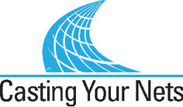
In Partnership with
Notes:
Leader – Three mission organisations working together under ‘Casting Your Nets’ to provide training to make ‘evangelism easy for everyone’.
It’s a good idea to have a look at the website of each organisation – Outreach UK, Good News and Pocket Testament League. This will give you further information about each and what they offer you and your church.
www.outreachuk.com
www.goodnews-paper.org.uk
www.ptluk.org
LEADER – At the start of this session - Make sure you know which slide relates to each part of this topic in the OUK Evangelism Handbook before leading the session.
Helpful notes for this training session are found on pages 76, 85 - 89 of the Outreach UK Evangelism Handbook.

Slide 3

MARK 1 v 14 – 15:
¹⁴ After John was put in prison,
Jesus went into Galilee,
proclaiming the good news of God. ¹⁵ “The time has come,”
he said.
“The kingdom of God has
come near. Repent and believe
the good news!”
Notes:
Leader – Mark 1 v 14-15 – the message of repentance and believing in Jesus is followed by our commission.
Jesus calls us to follow him – and part of that calling is to share our faith in Him. This is not an optional extra, but for all Christians.

Slide 4
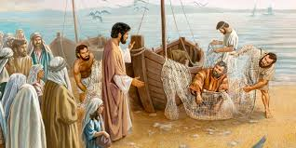
Mark 1 v 17 – 18:
‘Come follow me’, Jesus said, ‘and I will make you fishers of men. At once they left their nets and followed him.
Notes:
Leader – Mark 1 v 17-18 – the message of repentance and believing in Jesus is followed by our commission.
We find that the disciples immediately (at once) they left their nets.
This then became the new priority for them – they committed their lives to proclaiming the truth of the gospel.
Thus the Church grew as people put their trust in Jesus as Saviour and Lord.

Slide 5
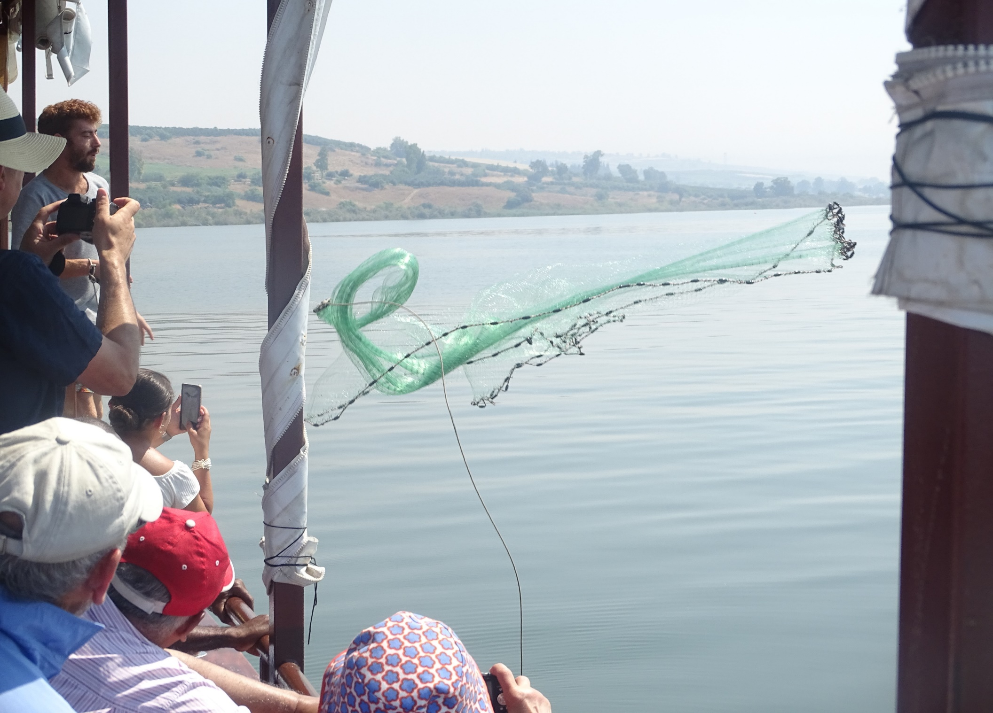
John 21 v 6:
‘Cast your net on the
other side of the boat
and you will find fish.’
Notes:
Leader – background information.
The verse from John 21 v 6 – ‘Cast your net on the other side of the boat and you will find fish’ – is the foundation to the ‘Casting Your Nets’ initiative. It not only encourages and instructs us to fish (for souls in this context) but also to try different ways and different places to catch them. We need to be proactive in our ‘fishing’ – not passive, just waiting for fish to come to us and jump into the net! Jesus came to ‘seek and save what was lost’ (Luke 19 v 10)
You may want to read these verses and add your own examples to encourage the need to ‘go’ with the gospel.
(Photo by kind permission of Andy Godfrey (OUK Evangelist) taken on the Sea of Galilee)

Slide 6
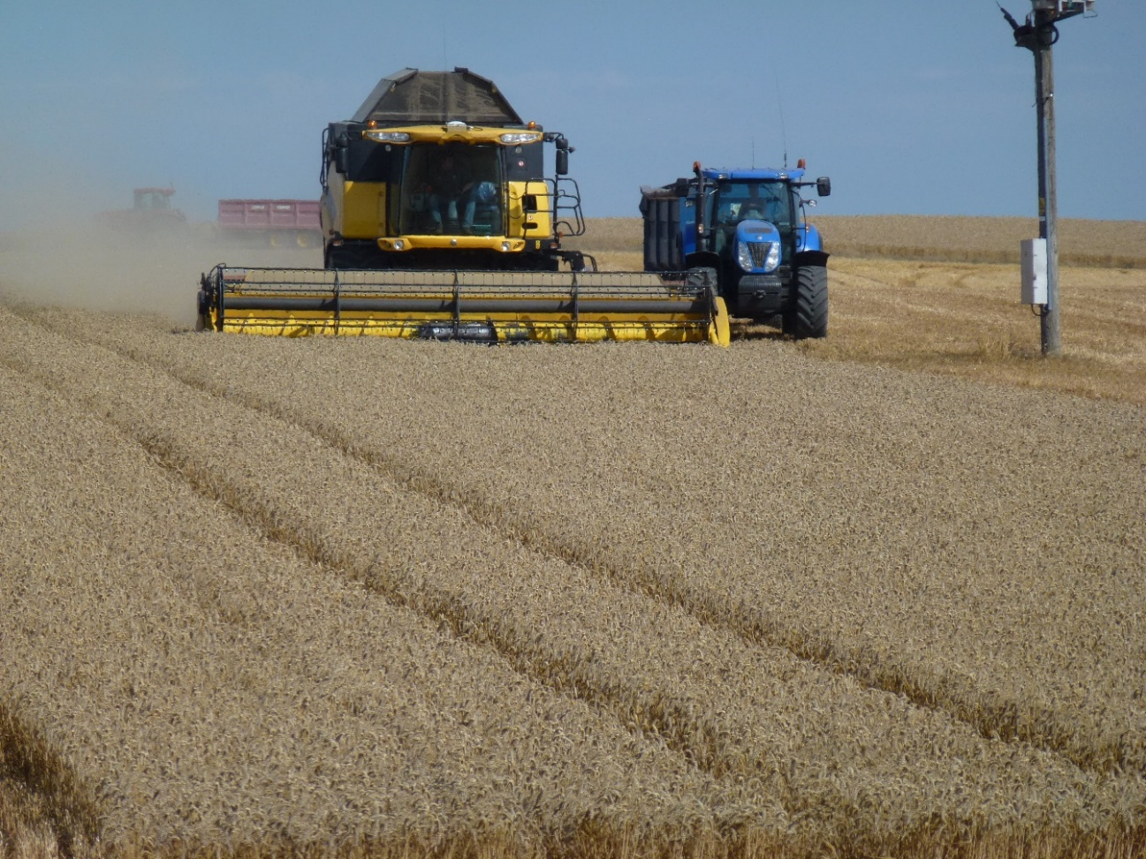
What is Achieved?
‘The harvest is plentiful, but
the workers are few.’
Matthew 9 v 37
Notes:
Leader – In this presentation we are looking at what can be achieved through reaching out with the gospel.
It is our calling to ‘make the gospel known’, and it is God’s work to bring fruit as He touches people’s hearts and minds by His Holy Spirit.
Please see pages 39 – 40 in the Outreach UK Evangelism Handbook for this session’s headings.
Opening question –
Ask your group – ‘What do you think will be achieved by ‘going’ with the Gospel?
We find that there is never a problem with the harvest – as we are reminded by the verse above. It is ‘plentiful’ or abundant. The problem is in the number of workers sent out into the ‘harvest fields’. It is worth noting that the workers are ‘sent out’ – v 38. This is not ‘Come to us and hear the Gospel’, this is ‘Go out’ – taking the Gospel message with you. See also Mark 16 v 15 and Matthew 28 v 19, 20 – and the early Church in Acts.

Slide 7

JESUS’ FOCUS
John 4 v 34 – 35:
“My food,” said Jesus,
“is to do the will of him who
sent me and to finish his work.
³⁵ Don’t you have a saying,
‘It’s still four months until
harvest’? I tell you, open your eyes and look at the fields! They are ripe for harvest.
THE PROMISE:
Romans 10 v 13 – 17:
¹² For there is no difference between Jew and Gentile—the same Lord is Lord of all and richly blesses all who call on him, ¹³ for, “Everyone who calls on the name of the Lord will be saved.”
¹⁴ How, then, can they call on the one they have not believed in? And how can they believe in the one of whom they have not heard? And how can they hear without someone preaching to them? ¹⁵ And how can anyone preach unless they are sent? As it is written: “How beautiful are the feet of those who bring good news!”
¹⁶ But not all the Israelites accepted the good news. For Isaiah says, “Lord, who has believed our message?”^{[17} Consequently, faith comes from hearing the message, and the message is heard through the word about Christ.
Notes:
Romans 10 v 13 – 15 – Here is the promise about those who ‘call on the name of the Lord’ – they will be saved. But how can they call – unless they have heard?
(Romans 10 v 15 [NET version] – ‘How timely is the arrival of those who proclaim good news.’)
John 4 v 34 – ‘My food’, said Jesus, ‘is to do the will of him who sent me and to finish his work. Do you not say, ‘Four months more and then the harvest, I tell you, open your eyes and look to the fields they are ripe for harvest.’
Jesus was very clear about His focus – but the disciples were more concerned about their own hunger and need for physical food.

Slide 8
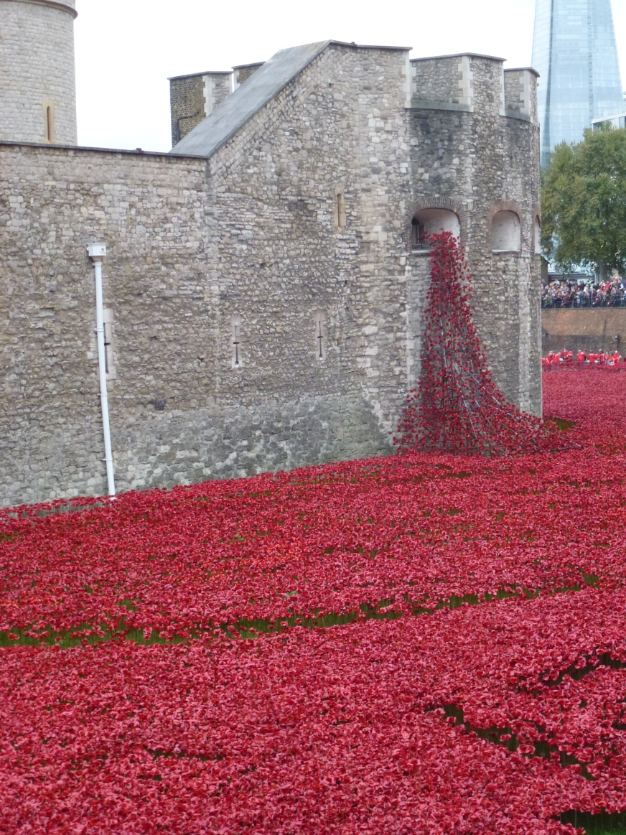
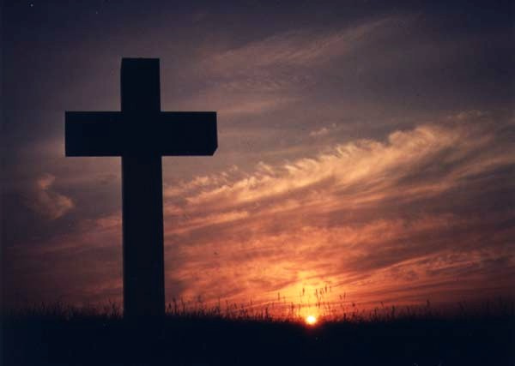
Raising Awareness
Notes:
Leader -
Many in society today know little or nothing of what Christians believe – and much of what they think they know is wrong!
The two pictures illustrate the need to ‘raise awareness’. The first shows the famous poppies display at the Tower of London, which raised awareness of the thousands who lost their lives in the first world war. The second picture – the Cross – raises awareness of why Jesus died, his sacrificial death for the salvation of sinners – and the empty cross proclaims His resurrection. As we go, we can raise awareness of who Jesus is, why he came to die and the implications for each one of us.
We can also raise awareness of our local church and what goes on each week. You may run clubs for the young and elderly, or Bible study groups, or support for young mums and dads – we can tell those we meet what our church does. However, we mustn’t turn our evangelism into just a ‘come to us’ message – it’s Jesus who people need to meet first and foremost, though our groups might help in that.
People around the disciples knew that things were changing – the world was being turned upside down (or the right way up!). See Acts 17 v 6 – ‘These men who have turned the world upside down, have now come here’ (ESV).
Acts 6 v 7 – ‘So the word of God spread. The number of disciples in Jerusalem increased rapidly, and a large number of priests became obedient to the faith.’

Slide 9

Gain Credibility
Matthew 5 v 14 – 16:
‘You are the light of the world. A town built on a hill cannot be hidden. Neither do people light a lamp and put it under a bowl. Instead they put it on its stand, and it gives light to everyone in the house. In the same way, let your light shine before others, that they may see your good deeds and glorify your Father in heaven.’
Notes:
The Church has lost trust in many areas – and consequently so has Christianity, but by going out and meeting people where they are we can build relationships – bridges of credibility and trust.
Who do we know who now trusts the Gospel message as a result of building a relationship with them? Sharing our lives with demonstrations of trust and credibility lays a foundation for the Gospel.
Over 80% of people who become Christians do so after a Christian has built a relationship of trust with them, according to Luis Palau campaign director Dan Owens.
Matthew 5 v 14 - 16 – ‘You are the light of the world. A town built on a hill cannot be hidden. Neither do people light a lamp and put it under a bowl. Instead they put it on its stand, and it gives light to everyone in the house. In the same way, let your light shine before others, that they may see your good deeds and glorify your Father in heaven.’
As we build trust with others, so they begin to trust our message – and then God himself, which is much more important!

Slide 10

Jesus is Honoured
Notes:
It’s about love and obedience to God and His instructions. Jesus said ‘Go’ – so we go! Thus Jesus is honoured as we follow His teaching. ‘Come, follow me’, Jesus said, ‘and I will make you fishers of men’ – Mark 1 v 17. The response from those called was – ‘’At once they left their nets and followed him” (Mark 1 v 18).
So often we have turned the ‘go’ of the gospel into, ‘come to us’ – we expect people to come where we are comfortable, where they may be uncomfortable. Perhaps we need to turn that around – and go to where we feel uncomfortable for the sake of those going to a lost eternity.

Slide 11
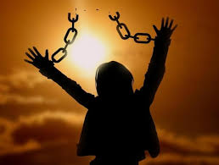
Cults are Countered
John 8 v 32:
‘Then you will know
the truth, and the truth will set you free.’
Notes:
Leader – Questions to ask your group and watch for the responses:
How many have been visited by Jehovah’s Witnesses?
How many have been visited by a Mormon?
How many have been visited by someone from a local church who is wanting to share their faith in Jesus Christ?
I expect you, like me, have been visited in our homes by Jehovah’s Witnesses or Mormons, or been approached in a town centre by members of cults.
As Christians, we have the true Gospel to share – and through taking the Gospel ‘out’ into our communities and town centres we counter the false ‘gospel’ which is not the Gospel (Good News) at all.
Having asked your group who has been visited by a JW or Mormon, most, if not all, will agree that they have.
But what about a Christian? Who had been visited by someone from a local church who wants to share the true Gospel? Most will acknowledge they have never been visited in this way. How sad. As churches we have left our communities untouched by the true Gospel – and left enquirers (those seeking God) vulnerable to a false gospel.
Encourage your group by letting them know that there are people in our communities who are just waiting for a Christian to call and share the Gospel with them – showing love, concern and compassion. We are not there to ‘preach at’ people, but to ‘come alongside’ them and share the good news.

Slide 12

Excuses are Eliminated
“No one's told me”
Notes:
In times past, most people around the UK would have been brought up with some sort of knowledge of the Bible and what Christians believe. Whether at Sunday School, Christian youth clubs or even in RE lessons at school. This is no longer the case. There is a great deal of ignorance of true Christianity and much of what people think they know is wrong.
Thus our evangelism is not only about sharing the true gospel message, it is often about sharing the truth about what Christians really believe. We are then able to share the true Gospel - salvation through knowing Jesus Christ as Saviour and Lord through repentance of sin and faith in Him.
We are not there to impose our faith, but expose it! We may win an argument – but lose the person. Compassion and tact are needed, along with love for the lost.
You may want to think about the types of words we use to share what we believe – as those we are speaking with may not understand our ‘Christian language’.
Sin?
Salvation?
Repentance?
What other words might we use to share the gospel (good news)?
(See page 64 of the Outreach UK Evangelism Handbook)
Perhaps a question to use on occasions is – ‘Have you understood what I’ve been talking about? Does it make sense?’
(See Grove Publication Ev 100 – ‘The Gospel Message Today: Language that Connects in Communicating the Gospel’ – By Laurence Singlehurst.)

Slide 13

Seekers are Sought
Luke 19 v 10:
“The Son of man came to seek and save the lost.”
1 Peter 3 v 15:
‘But in your hearts set apart Christ as Lord. Always be prepared to give an answer to everyone who asks you to give the reason for the hope that you have. But do this with gentleness and respect.’
Notes:
Seekers are sought by God - praise the Lord!
We will meet people who are wanting to know Jesus Christ as Saviour and Lord – there are those who are seeking the truth about God and how to know Him. As we seek God in prayer, we ask Him to lead us to those who are seeking Him.
Perhaps this is a prayer you might like to pray each day: ‘Lord, lead me today to the person you want me to speak to about you.’
We need to be ready, so that when we find people who are seeking a relationship with God, we are ready to give an answer – to help them come to know Jesus Christ as Saviour and Lord.
Look at 1 Peter 3 v 15 – ‘But in your hearts set apart Christ as Lord. Always be prepared to give an answer to everyone who asks you to give the reason for the hope that you have. But do this with gentleness and respect.’ (Click to appear on screen)
Luke 19 v 10 – Zacchaeus – seeking after God. (See above)
Luke 15 v 11 – 24 - Jesus speaking about the lost sheep – being prepared to do what’s needed to help someone become safe, in a relationship with God.
What are the key words in this verse? What are we being asked to do – and how?

Slide 14
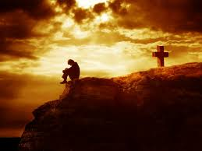
Backsliders are Befriended
BIBLICAL EXAMPLES
Peter – John 21 v 17:
The third time he said to him, “Simon son of John, do you love me?” Peter was hurt because Jesus asked him the third time, “Do you love me?” He said, “Lord, you
know all things; you know that
I love you.” Jesus said, “Feed
my sheep.
John Mark – 2 Tim 4 v 11:
Only Luke is with me. Get Mark and bring him with you, because he is helpful to me in my ministry.
Who do you know?
Notes:
Leader – Questions for your group:
Who do you know who has fallen away from following Jesus?
What are the reasons for people falling away from following Jesus?
Perhaps that’s you – or someone else you know?
Many who used to follow Jesus have ‘fallen by the wayside’ – and, for a number of reasons, stopped being committed to following Jesus.
We are not to condemn, but to encourage, befriend and support them – so that they can rejoin the family of believers. Perhaps praying for them on a regular basis will help them – and you as you seek to share as God directs by His Spirit.
Love, grace and compassion – not judgement or condemnation.
It’s very easy to point the finger at others, forgetting that three are pointing back to you and one to God!

Slide 15
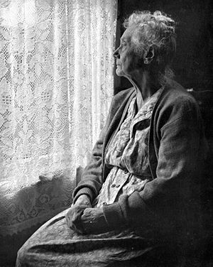
The Lonely are Loved
BIBLICAL EXAMPLE:
James 1 v 27 – ‘Religion that God our Father accepts as pure and faultless is this: to look after orphans and widows in their distress and to keep
oneself from being
polluted by the world.’
Notes:
Leader – Ask your group if any have ever felt lonely?
Perhaps you have – if so, share how you felt and encourage your group to share too.
We live at a time when there is a loneliness epidemic – statistics say that ‘60% of over 60s will not see anyone to speak to from Friday evening through to Monday morning’ (Daily Mail, 26th January 2015).
James 1 v 27 – ‘Religion that God our Father accepts as pure and faultless is this: to look after orphans and widows in their distress and to keep oneself from being polluted by the world.’
Further example - Elijah felt very alone – this caused him to get depressed, to run for his life, not wanting to be with anyone. There may be those who find solitude attractive, but it may not be good for them, so patience and compassion are needed to help them become open to time with others. (1 Kings 19)
There are many who find themselves in a place of loneliness – the young mother, the single parent, the elderly man or woman on their own. Who do we know? Perhaps a personal visit or phone call might just encourage someone today that they are not forgotten, but are important and loved. Who live near our church buildings but have never been visited – who are lonely and also need to hear about God’s love for them?

Slide 16
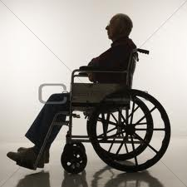
Housebound are helped
BIBLICAL EXAMPLE
Peter’s mother-in-law – Luke 4 v 38-39:
Jesus left the synagogue and went to the home of Simon. Now Simon’s mother-in-law was suffering from a high fever,
and they asked Jesus to help her.
So he bent over her and rebuked
the fever, and it left her. She got
up at once and began to wait
on them.
Notes:
Disabilities can sometimes be seen, but others can remain hidden. Who lives near your church building who may need a visit or some practical help? Never offer what you can’t fulfil, however.
It’s not just about meeting people’s physical needs – but their spiritual ones too. Maybe hold a homegroup at the home of the person who can’t get out so that they can be there. A few practical changes could make all the difference between being included or excluded.
At a practical level, don’t makes promises you can’t keep – but some practical help may be needed.
It’s important not to forget a person’s spiritual need – to know Jesus as Saviour and Lord.
Even if someone might be housebound, we can still encourage them by inviting them to Zoom get-togethers or a simple phonecall.
One older lady wanted to witness – and found an opportunity to do so to her carer. Some carers will take their patient to a church service – and then hear the Gospel too.

Slide 17

Children are Called
BIBLICAL EXAMPLE
Mathew 19 v 13 – 15:
Then people brought little children to Jesus for him to place his hands on them and pray for them. But
the disciples rebuked them.
Jesus said, “Let the little
children come to me, and do
not hinder them, for the
kingdom of heaven belongs
to such as these.” When
he had placed his
hands on them, he
went on from there.
Notes:
It’s a fact – many children in the past became Christians through Sunday Schools, youth groups, Crusaders, Boys and Girls Brigade, etc. They heard of a God who loved them and wanted a relationship with them through repentance and faith in Him.
What does your church offer to young people?
Also, what do you offer for others who live in the local community? Do you have a lunch club, after school groups, youth groups, parents and toddlers groups, etc.?
Think about what you already do as a church – and what needs their might be in your community – to reach others with the Gospel message.
It might be worth going out, visiting the community and asking them what they think is lacking in their area for young people and children. Don’t promise what you can’t fulfil – check your resources before starting something new. It may be better for you to reach older folk if this is your church’s demographic.

Slide 18

Souls are Saved
BIBLICAL EXAMPLE
1 Corinthians 3 v 5 – 9:
What, after all, is Apollos? And what is Paul? Only servants, through whom you came to believe—as the Lord has assigned to each his task. I planted the seed, Apollos watered it, but God has been making it grow. So neither the one who plants
nor the one who waters is anything, but
only God, who makes things grow. The
one who plants and the one who waters
have one purpose, and they will each
be rewarded according to their own
labour. For we are co-workers in
God’s service; you are God’s
field, God’s building.
Notes:
Hallelujah – people do become Christians!
What’s your story of coming to know Jesus as Saviour and Lord?
Why not break into pairs and take two minutes each to share your story. (You may also want to have some further training on ‘Sharing Your Story’ – if so, the ‘Casting Your Nets’ initiative offers a free PowerPoint training session to help you. See www.castingyournets.co.uk for further information.)
Sharing stories of people who’ve come to know Jesus as Saviour and Lord encourages others to share their story – and can be used in Sunday Services to encourage evangelism.
Example – An elderly man, having been visited, acknowledged he had problems, was lonely and dependent on alcohol. The local chapel members visited him, invited him for meals and befriended him. God was at work and one morning he called out to Jesus, repented of his sins and his life was transformed. Immediately, he wanted to start sharing about how God had changed his life. It also resulted in him getting married for the first time at the age of 76 – God called him ‘home’ at the age of 98 – still praising the Lord!
God is still transforming peoples lives! Who do you know?
(Please share your own stories – from your own experiences of God at work.)

Slide 19

God’s word is obeyed
1 John 5 v 3
‘This is love for God: to obey His commands.
And His commands are not burdensome.’
Notes:
Leader - We’ve come full-circle. We’re back to God’s Word, which is what we want to obey as Christians, as followers of Jesus Christ.
Take a look at 1 John 5 v 3 – and also look at 2 Corinthians 5 v 11 to 6 v 2 (shown on slides 20 – 22).
As a group, why not work through the questions on slides 20 to 22 together (you can choose to create your own questions, or use those suggested as a starter).
You may also like to read Romans 1 v 14 – 17 and think about the basics of the Gospel message – and Paul’s response to its effect on his life.

Slide 20

2 CORINTHIANS 5 v 11 – 6 v 2
PAUL’S COMPULSION TO SHARE THE GOSPEL
¹¹ Since, then, we know what it is to fear the Lord, we try to persuade others. What we are is plain to God, and I hope it is also plain to your conscience. ¹² We are not trying to commend ourselves to you again, but are giving you an opportunity to take pride in us, so that you can answer those who take pride in what is seen rather than in what is in the heart. ¹³ If we are “out of our mind,” as some say, it is for God; if we are in our right mind, it is for you. ¹⁴ For Christ’s love compels us, because we are convinced that one died for all, and therefore all died. ¹⁵ And he died for all, that those who live should no longer live for themselves but for him who died for them and was raised again. ¹⁶ So from now on we regard no one from a worldly point of view. Though we once regarded Christ in this way, we
do so no longer. ¹⁷ Therefore, if anyone is in Christ, the new creation has come:^{[a]} The old has
gone, the new is here! ¹⁸ All this is from God, who reconciled us to himself through Christ and
gave us the ministry of reconciliation: ¹⁹ that God was reconciling the world to himself in
Christ, not counting people’s sins against them. And he has committed to us the
message of reconciliation. ²⁰ We are therefore Christ’s ambassadors, as though God
were making his appeal through us. We implore you on Christ’s behalf: Be
reconciled to God. ²¹ God made him who had no sin to be sin for us, so that in
him we might become the righteousness of God…
Notes:
Leader – This slide, and the next one (slide 21) are linked (where you will find these questions on the slide ready for your group to discuss). It is also linked with the previous slide, 19.
What is Paul’s driving force, his compulsion to share the Gospel? (2 Corinthians 5 v 11 – 14)
Who has changed Paul’s life – and ours? (v 14 – 19)
There is a message we are called to share – what is its effect? (v 16 – 20)
Why do we have ‘good news’ to share? (v 21) (Perhaps one of the most astounding verses of the Bible!)
Is there any urgency to sharing the Gospel? (6 v 1, 2) – See slide 21
You may also like to read Romans 1 v 14 – 17 – and think about the basics of the Gospel message – and Paul’s response to its effect on his life. (See slide 23)
(ALSO - see notes on pages 30 – 36 in the Outreach UK Evangelism Handbook)

Slide 21

PAUL’S COMPULSION TO SHARE THE GOSPEL.
A FEW QUESTIONS FROM 2 Corinthians 5 v 11 – 6 v 2
What is Paul’s driving force, his compulsion to share the Gospel?
Who has changed Paul’s life – and ours? (v 14 – 19)
There is a message we are called to share – what is its effect?
(v 16 – 20)
Why do we have ‘good news’ to share? (v 21)
(Perhaps one of the most astounding verses of the Bible!)
Is there any urgency to sharing the Gospel? (6 v 1, 2)
You may also like to read Romans 1 v 14 – 17 – and think about the
basics of the Gospel message – and Paul’s response to its effect
on his life.
Notes:
Leader – you can use these questions to encourage your group to think about Paul’s attitude to sharing the Gospel – and ours.

Slide 22
2 Corinthians 6 v 1,2
As God’s co-workers we urge you not to receive God’s grace in vain. For he says,
“In the time of my favour I heard you,
and in the day of salvation I helped you.”
I tell you, now is the time of God’s favour, now is the day of salvation.’
Notes:
Leader – linked with previous 3 slides
2 Corinthians 6 v 1, 2 - Is there any urgency to sharing the Gospel? (6 v 1, 2)

Slide 23

Disciples are made
Jesus said, ‘Go and make disciples.’
^{ROMANS 1 v 14 – 17:}
“I am obligated both to Greeks and non-Greeks, both to the wise and the foolish. ¹⁵ That is why I am so eager to preach the gospel also to you who are in Rome.
¹⁶ For I am not ashamed of the gospel,
because it is the power of God that
brings salvation to everyone who believes: first to the Jew, then to
the Gentile. ¹⁷ For in the gospel the
righteousness of God is revealed
— a righteousness that is by
faith from first to last, just
as it is written: “The
righteous will live by faith.”
Notes:
Leader - The objective of the great commission by Jesus is to ‘Go and make disciples’, not just converts or decisions. (Like, just raising a hand!)
As you go in obedience to the Great Commission your own faith will grow – as will your prayer life and your knowledge of the Bible as you turn to it to answer people’s questions and doubts.
You are called to ‘GO’ - to become a true disciple.
Question to ask – Can it be said, ‘If you are not witnessing to others, you are not a true disciple?!’ Discuss?

Slide 24
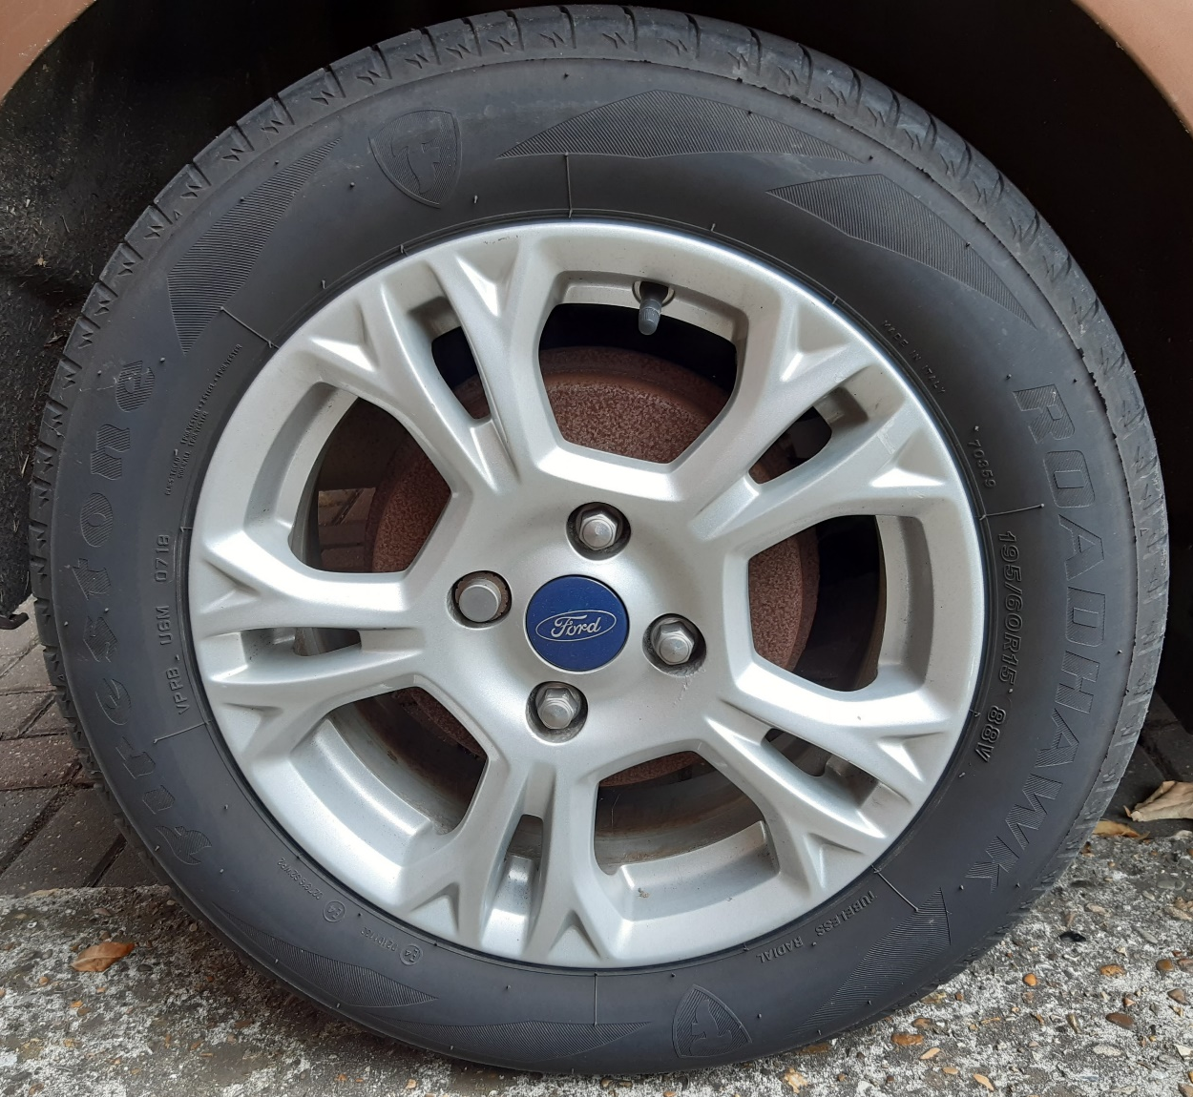
Worship
Prayer
Jesus
Fellowship
Faith
God’s Word
Notes:
Leader –
It’s not only our going out with the Gospel that will cause a response – as we have been seeing, but we ourselves will grow in our relationship with Jesus, trust in His Word as we see Him fulfil what He says He will do, but also in fellowship with our brothers and sisters too.
Perhaps, like the picture – we can see this as a wheel of growth that will keep us close to God and our fellow Christians, but also moving out towards those who need to hear the good news about Jesus Christ, His Gospel.
Thus we have –
Growing in Prayer – as we speak to God about others and his work of evangelism.
Growing in God’s Word – as we look for God’s answers to the difficult questions we may be posed by enquirers – as well as getting to know God better for ourselves
Growing in Worship – as we rejoice in our own salvation and also, as we see God at work in us and others.
Growing in Fellowship – we are called to be part of a family where we support, encourage and pray for each other. This leads to fruitful fellowship.
Growing in Faith – as we see God doing ‘more than we can ask or even imagine’ – Ephesians 3 v 20, 21.
Knowing Jesus and serving Him is at the centre of who we are and what we do – Jesus is Lord of our lives (we are ‘in Christ’), directing our thoughts and actions and through the work of the Holy Spirit, souls are saved. (Paul – 1 Corinthians 1 v 18 & 2 Corinthians 5 v 5)

Slide 25
FOR MORE INFORMATION AND
GOSPEL LITERATURE PLEASE CONTACT:
www.outreachuk.com
info@outreachuk.com
0300 123 1990
www.goodnews-paper.org.uk
goodnewseditor@ntlworld.com
0115 9233324
www.ptluk.org
admin@ptluk.org
01903 705362
Notes:
End of session on ‘What is Achieved’.
Leader –
It’s a good idea to always have evangelistic literature available for your church members to use. We would recommend that you order Good News newspapers each month and have a supply of PTL Gospels ready to be given away. Use the details on this slide to get in touch with Good News and PTL. If you want further help in evangelism training, Outreach UK have experienced evangelists available to help and support you – please get in touch using the details above.
Look for opportunities this week to share the Gospel – and be encouraged as you see what God is doing through you.
Outreach UK has a team of Associate Evangelists, each pledge to carry out 12 hours evangelism each month – in return, they get support, training and some free resources. If you or someone in your group is interested in knowing more about becoming an Outreach UK Associate Evangelist, please get in touch through the details on the slide, we’d love to hear from you.
May you know God’s blessing and encouragement as you reach out with the Gospel.
End with prayer.

