Slide 1

Evangelism made easy for
everyone
Notes:
Welcome to ‘Casting Your Nets’.
Casting Your Nets is an initiative between Outreach UK, Good News newspaper and Pocket Testament League – to enable every Christian to share their faith in Jesus Christ.
You may already be doing that – in which case we pray that this course will encourage, inspire and perhaps, hone your gifts.
Alternatively, you may be coming to this course because you know you should be sharing your faith in Jesus Christ, but for some reason find that impossible or difficult. This course will help you to have more confidence and will show you that, whoever you are, God can – and wants – to use you to speak about Him.
Each session is both theory and practical – so we encourage you to try putting into practice what you’ve learnt between sessions – and then share about your experiences when you next meet together.
Remember, we are not all the same. We are not all extroverts, or introverts, but we are all brothers and sisters in Christ. Encourage and support each other – and grow in knowing Jesus and sharing about Him.
The Leader –
Prepare by going through each session beforehand.
Make sure the Power-point will play on the equipment you have available.
Have your Outreach UK Evangelism Handbook with you.
Copy the relevant pages from the PDF copy of the Outreach UK Evangelism Handbook so that they are available for each participant – I suggest you give these out at the end of each session.
Each participant will need –
A Bible
A notebook
A pen/pencil
And - be ready to participate.
You may also want to purchase further copies of the Outreach UK Evangelism Handbook for each participant – if so, please contact Outreach UK via info@outreachuk.com or call 0300 123 1990 - we’ll be happy to help you. It is a great resource for every Christian to have and use.

Slide 2



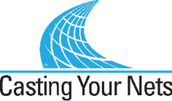
In partnership with
Notes:
Leader - Three mission organisations working together under ‘Casting Your Nets’ to provide training to make ‘evangelism easy for everyone’.
It’s a good idea to have a look at the website of each organisation – Outreach UK, Good News and Pocket Testament League. This will give you further information about each and what they offer you and your church.
www.outreachuk.com
www.goodnews-paper.org.uk
www.ptluk.org
LEADER – At the start of this session, make sure you know which slide relates to each part of this topic in the OUK Evangelism Handbook before leading the session.
Read pages 20-21.

Slide 3

MARK 1 v 14 – 15:
¹⁴ After John was put in prison,
Jesus went into Galilee,
proclaiming the good news of God. ¹⁵ “The time has come,”
he said.
“The kingdom of God has
come near. Repent and believe
the good news!”
Notes:
Leader – Mark 1 v 14-15 – the message of repentance and believing in Jesus is followed by our commission.
Jesus calls us to follow Him – and part of that calling is to share our faith in Him. This is not an optional extra, but for all Christians.

Slide 4
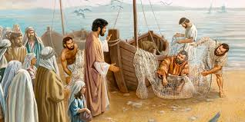
Mark 1 v 17 – 18:
‘Come follow me’, Jesus said, ‘and I will make you fishers of men. At once they left their nets and followed him.’
Notes:
Leader – Mark 1 v 17-18 – the message of repentance and believing in Jesus is followed by our commission.
We find that the disciples immediately (at once) left their nets.
This then became the new priority for them – they committed their lives to proclaiming the truth of the Gospel.
Thus the Church grew as people put their trust in Jesus as Saviour and Lord.

Slide 5
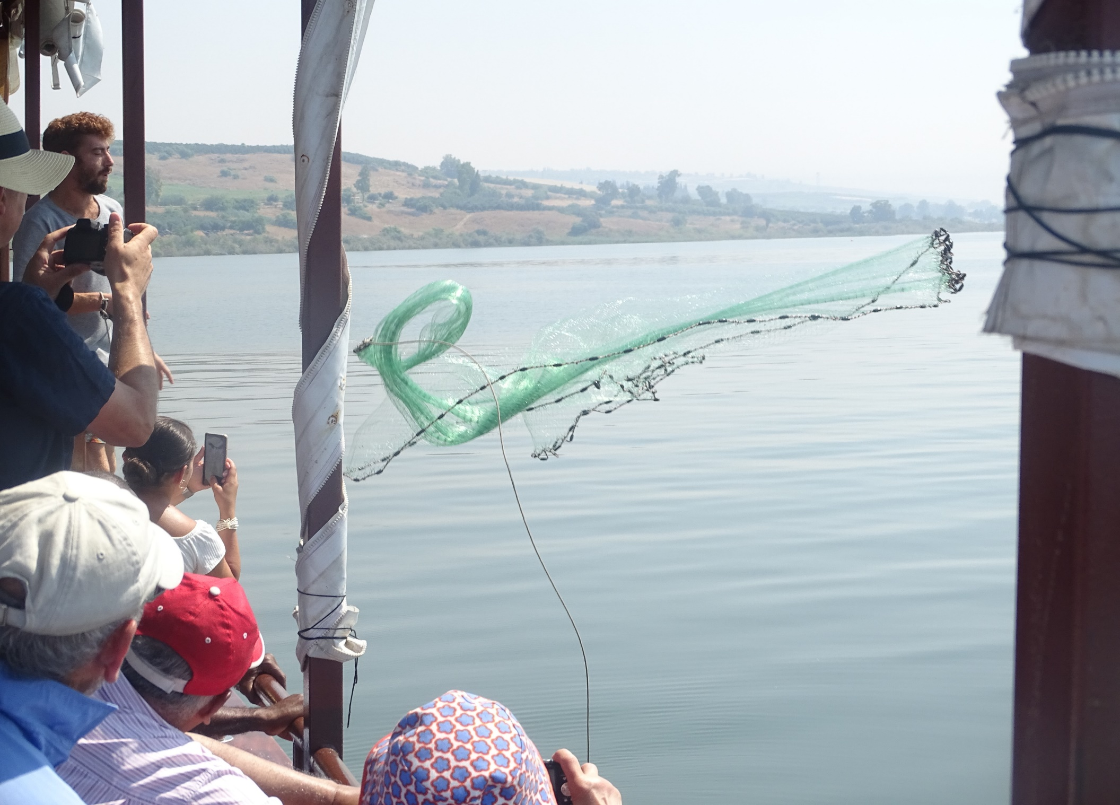
John 21 v 6:
‘Cast your net on the
other side of the boat
and you will find fish.’
Notes:
Leader –
The verse of John 21 v 6 – ‘Cast your net on the other side of the boat and you will find fish’ – is the foundation for the ‘Casting Your Nets’ initiative.
It not only encourages and instructs us to fish (for souls in this context) but also to try different ways and different places to catch them.
We need to be proactive in our ‘fishing’ – not passive, just waiting for fish to come to us and jump into the net!
Jesus came to ‘seek and save what was lost’ (Luke 19 v 10).
You may want to read these verses and add your own examples to encourage the need to ‘Go’ with the gospel.
(Photo by kind permission of OUK Evangelist Andy Godfrey, taken on the Sea of Galilee)

Slide 6
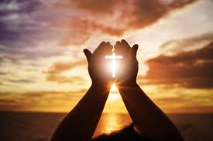
Gospel opportunities
Acts 1 v 8 – ‘But you will receive power when the Holy Spirit comes on you and you will be my witnesses.’
Notes:
Leader –
This training session is designed to encourage every Christian to see that God wants to use us in His plans and purposes to share the Gospel. But He doesn’t expect us to do it in our own strength or on our own – He wants to come alongside us and get personally involved with how we reach others with the Gospel. By His Spirit, He is able to show us who He wants us to speak to, and can give us the right words to say.
Jesus commanded the Church to spread the Gospel, as we read in Mark 16 v 15: ‘He told them, ‘Go into all the world and preach the Good News to everyone.’
Also in Matthew 28 v 19-20: ‘Go and make disciples of all the nations, baptizing them in the name of the Father and the Son and the Holy Spirit. Teach these new disciples to obey all the commands I have given you. And be sure of this: I am with you always, even to the end of the age.’
Acts 1 v 8 – Read this verse – which will appear on the screen.
This commission is to all Christians, who are all empowered by the Holy Spirit to be his witnesses. We have not been left alone to decide our own strategies or to just follow our own thoughts – but we are all called to obedience, and told to follow the leading of God’s Holy Spirit. The Holy Spirit is given to all Christians, not just a few, so all Christians are called to witness, not just those who are specifically called to be evangelists (Ephesians 4 v 11-12).

Slide 7

Praying for yourself and others
“Devote yourselves to prayer, being watchful and thankful. ³ And pray for us, too, that God may open a door for our message, so that we may proclaim the mystery of Christ, for which I am in chains. ⁴ Pray that I may proclaim it clearly, as I should. ⁵ Be wise in the way you act toward outsiders; make the most of every opportunity. ⁶ Let your conversation be always full of grace, seasoned with salt, so that you may know how to answer everyone”. Colossians 4 v 2 – 6
This is a suggested prayer to use at the beginning of every day:
‘Lord, lead me today to the person You
want me to speak to about You.’
Notes:
Leader –
Please note – Paul is in prison and is still seeking opportunities to share about his faith in Jesus Christ. Nothing was going to stop Paul speaking of Jesus – not even prison or persecution. Firstly, having encouraged the Colossians to pray for themselves, he then asks them to pray for him in a specific way, asking…
That God would open a door for the message
That Paul may proclaim the mystery of Christ
That he would proclaim it clearly
He then says to the Colossians….
Be wise in dealing with outsiders (unbelievers)
Make the most of every opportunity
Let your conversation be full of grace, seasoned with salt, so that you may know how to answer everyone.
Leader – can you add a personal story of missing a Gospel opportunity, messing up a Gospel opportunity – or even being given a surprising opportunity, one you weren’t expecting? If you can, that would be a good thing to do. Perhaps someone in your group will also be able to share too.
Some fears that Christians often have about witnessing to others:
Missed opportunities
Not knowing what to say
Feeling guilty for not presenting the Gospel with clarity.
So the suggested prayer is very helpful to all Christians as we seek to witness – perhaps this can become a daily prayer for each member of your church.
Leader –
Perhaps, before showing this slide you may want to ask your group about their prayer activity. Don’t be hard or condemning, but encouraging!
When do they pray?
What do they pray about?
Do they pray for Gospel opportunities?
Do they pray for people to be saved – become Christians, followers of Jesus, disciples.
‘Lord, lead me today to the person You want me to speak to about You.’
This is a ‘sample’ prayer – and has been used by one Outreach UK evangelist for many years – proving to be a prayer that God loves to answer.
If we pray it – we need to be ready to ‘speak’!

Slide 8
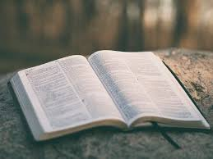
What exactly is a Christian?
THE BIBLE ONLY USES THE WORD ‘CHRISTIAN’
THREE TIMES:
- A CHRISTIAN IS A DISCIPLE
ACTS 11 v 26 – ‘The DISCIPLES were first called CHRISTIANS at Antioch.’
- A CHRISTIAN HAS MADE A DECISION TO FOLLOW CHRIST
ACTS 26 v 28 – ‘Do you think you can persuade me to BECOME a CHRISTIAN?’
- A CHRISTIAN IS WILLING TO SUFFER FOR CHRIST
I PETER 4 v 16 – ‘However, if you SUFFER as a CHRISTIAN, do not be ashamed but
praise God that you bear that name.’
Notes:
Leader – It’s been found during previous evangelism training sessions that some attending may not be Christians themselves or unsure of what a Christian is. This might not be the case for you and those attending your session – however, we’ve included this slide for you to use, just in case.
This slide is also a reminder of what we are looking for, why we are evangelising – that others will come to know Jesus as Lord and Saviour – become a Christian. It’s disciples, not just decisions that we are to make. Christians are followers of Jesus, not just people who believe He existed.
Leader – It’s vital to be sure that each one of us truly knows Jesus Christ as Saviour and Lord – as these are the people who God is able to use in His plans and purposes. We can see this through reading the verses on the slide about Christians.
Questions to ask:
How do you become a Christian?
What is therefore a Christian?
What is expected from a Christian?

Slide 9
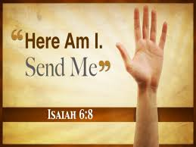
The kind of people god uses
‘In the year that King Uzziah died, I saw the Lord, high and exalted, seated on a throne; and the train of his robe filled the temple. ² Above him were seraphim each with six wings: With two wings they covered their faces, with two they covered their feet, and with two they were flying. ³ And they were calling to one another:
“Holy, holy, holy is the Lord Almighty; The whole earth is full of his glory.”
⁴ At the sound of their voices the doorposts and thresholds shook and the temple was filled with smoke. ⁵ “Woe to me!” I cried. “I am ruined! For I am a man of unclean lips, and I live among a people of unclean lips, and my eyes have seen the King, the Lord Almighty.”
⁶ Then one of the seraphim flew to me with a live coal in his hand, which he had taken with tongs from the altar. ⁷ With it he touched my mouth and said, “See, this has touched your lips; your guilt is taken away and your sin atoned for.”
⁸ Then I heard the voice of the Lord saying, “Whom shall I send? And who will go for us?”
And I said, “Here am I. Send me !”
Available people - Isaiah 6 v 1 - 8
Notes:
Leader – Please note this links to page 50 of the Outreach UK Evangelism Handbook where other scripture verses are listed, as well as some examples of people God uses. We are all different and have different skills and gifts but we all need to be available for God to use.
If we look at these verses in chapter 6 of Isaiah (see slide), we find there is someone who felt they were unqualified to work for God – but this wasn’t God’s view.
Perhaps you may be like that too – ‘Who am I that God can use me? I’m a nobody, nothing. I have very few skills, poorly educated’, etc. We can come up with many excuses as to why God shouldn’t or couldn’t use us.
Leader –
Isaiah 6 v 5 – Note Isaiah’s immediate reaction to God – ‘Woe to me!... I am ruined!’ He felt unworthy, unholy. Perhaps our immediate reaction to God’s call is – ‘Oh no, not me. There are much better people around than me – they are much better at ……………………….. I couldn’t do that!‘ But our sin has been atoned for; we are forgiven, so we are worthy – in God’s eyes.
In any case, God isn’t looking for perfect people, but available people. Read Isaiah 6 v 8, where Isaiah responds to God’s call – ‘Here am I, send me’. This is what the picture of the hand shows – I’m available.
God doesn’t use perfect people, because there aren’t any! It’s people who have encountered God – that’s who God can use.

Slide 10
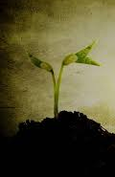
THE KIND OF PEOPLE GOD USES
^{5 ‘}What after all is Apollos and what is Paul, only servants through whom you came to believe - as the Lord has assigned his task.
⁶ I planted the seed, Apollos watered it, but God has been making it grow. ⁷ So neither the one who plants nor the one who waters is anything, but only God, who makes things grow. ⁸ The one who plants and the one who waters have one purpose, and they will each be rewarded according to their own labour. ⁹ For we are co-workers in God’s service; you are God’s field, God’s building.’
Dependent people – 1 Cor 3 v 5-7
Notes:
Leader –
Dependent people – 1 Corinthians 3 v 5-7. God isn’t looking for those who have all the abilities, but those who will follow Him and rely on Him – dependent on God, not themselves or their own abilities and skills – although God uses our natural abilities too.
Our calling to spread the Gospel is simple: we do our bit, and God does his bit. Read those verses again – ‘but God made it grow’. Read all the verses – 1 Corinthians 3 v 6-9.
It’s vital to remember that we are servants who God works through to bring others to believe in Christ – v 5.
God blesses us – and rewards us - v 8.
We are not to be jealous of others’ gifts but to use the gifts that God gives each one of us – and to encourage each in using their gifts. Everyone is needed, every gift from God is needed.
God must receive the GLORY!
(You may want to look at the teaching on pages 20 and 21 in the OUK Manual – on the different styles of evangelism God uses.)

Slide 11

The kind of people god uses
‘Do not get drunk on wine, which leads
to debauchery. Instead, be filled with the Spirit.’
Spirit-filled people - Ephesians 5 v 18
Notes:
Leader –
God calls us into a relationship with Him – and gives us His Holy Spirit ‘as a deposit’ (Ephesians 1 v 14 and 2 Corinthians 5 v 5) – He is at work in our lives.
Read – Ephesians 5 v 18.
We are commanded to be ‘filled with the Spirit’
This phrase indicates a continuous process (present imperative tense) – keep on being filled. Never stop being filled!
It is the key to producing the fruit of the Spirit – ‘love, joy, peace, patience, kindness, goodness, faithfulness, gentleness and self-control.’ (Galatians 5 v 22, 23)
It’s God’s will for you and me – ‘Therefore do not be foolish, but understand what the Lord’s will is.’ Ephesians 5 v 17
Walking in a close relationship with God involves us spending time with Him each day in prayer, reading His Word and listening to what He says to us.
(The Amplified Bible says: ‘Do not get drunk with wine… but be filled with the Holy Spirit and constantly guided by Him.’

Slide 12
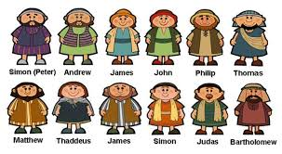
THE KIND OF PEOPLE JESUS USED!
Notes:
Leader –
Who would have chosen these? But God did! We can read through the New Testament and see how they turned the world ‘the right way up’! (Or, upside down!)
Four fishermen, a dodgy tax collector, a zealot, etc.
God chose you and me too – and He doesn’t make mistakes. Be confident that God wants to use each Christian, we are in His plans.

Slide 13
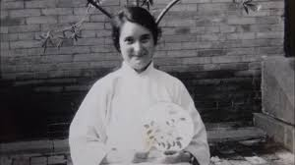
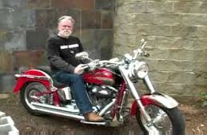

God uses all sorts –
GLADYS AYLWARD
BRIAN GREENAWAY
JONI
INCLUDING YOU!
Notes:
Leader –
We’ve suggested a few examples of those who the world may not have chosen as representatives, for one reason or another, but God chose them as his instruments to do great things for Him. You might like to take some time to look up each person on the internet – to add in a little background as to who they are and how God used them mightily.
Gladys Aylward – Rejected by many missionary societies, but felt called by God to share the Gospel in China – and used greatly by God to lead people to Christ in China. (See ‘Inn of the Sixth Happiness’ movie; her books may still be available too.)
Brian Greenaway – A Hells Angel converted through reading the Living Bible in Dartmoor Prison, who became an evangelist, telling others about Jesus.
Brian Greenaway’s book – ‘The Monster Within’ – is available from Amazon and eden.co.uk. His DVD - ‘The Monster Within’ – available at eden.co.uk. His video – ‘Where is Jesus Today?’ – is available on YouTube. (Please check – other people may sell these products.)
Joni Eareckson Tada - Paralysed as a young woman through a diving accident, but used by God to reach many with the Gospel throughout the world. She said: ‘I’d rather be in this wheelchair knowing God than on my feet without him.’ Joni has a number of books and a movie of her life, ‘Joni’, available on Amazon and Christian internet retailers like Eden.
Also, look how God used the frightened disciples to spread the Gospel around the world.
Please feel free to use your own illustrations of how God uses ‘ordinary’ people to be great men and women of God – to spread His Word.

Slide 14

the holy spirit can prompt us to -
Go and speak to a specific person
Visit a particular house
Work in a certain region
We will be LISTENING and PRAYING for his promptings as we evangelise and witness to others.
EXAMPLES FROM ACTS:
Acts 9 v 10 - 20: Ananias & Saul
Acts 10: Cornelius & Peter
Acts 13 v 1 - 4: Paul & Barnabas commissioned
Acts 16 v 6 - 10: Paul’s Macedonian call
Acts 18 v 1 - 11: Paul goes to Corinth. AND…
Notes:
Leader – Look at Page 49 in the OUK Evangelism Handbook for further examples if needed.
The Holy Spirit can prompt us – as illustrated by God leading Phillip to meet the Ethiopian in his chariot on the road to Gaza.

Slide 15
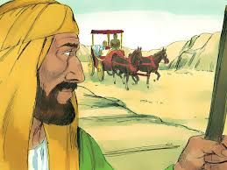
Phillip and the Ethiopian –
Acts 8 v 26 – 40
Now an angel of the Lord said to Philip, “Go south to the road—the desert road—that goes down from Jerusalem to Gaza.” ²⁷ So he started out, and on his way he met an Ethiopian eunuch, an important official in charge of all the treasury of the Kandake (which means “queen of the Ethiopians”). This man had gone to Jerusalem to worship, ²⁸ and on his way home was sitting in his chariot reading the Book of Isaiah the prophet. ²⁹ The Spirit told Philip, “Go to that chariot and stay near it.”
³⁰ Then Philip ran up to the chariot and heard the man reading Isaiah the prophet. “Do you understand what you are reading?” Philip asked.
Notes:
Leader –
Let’s read the passage – Acts 8 v 26 – 40 (also on slides 16, 17)
Look at slide 17 for further notes.

Slide 16
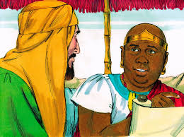
³¹ “How can I,” he said, “unless someone explains it to me?” So he invited Philip to come up and sit with him….
³² This is the passage of Scripture the eunuch was reading:
“He was led like a sheep to the slaughter,
and as a lamb before its shearer is silent,
so he did not open his mouth.
³³ In his humiliation he was deprived of justice.
Who can speak of his descendants?
For his life was taken from the earth.”^{[b]}
³⁴ The eunuch asked Philip, “Tell me, please, who is the prophet talking about, himself or someone else?” ³⁵ Then Philip began with that very passage of Scripture and told him the good news about Jesus.

Slide 17
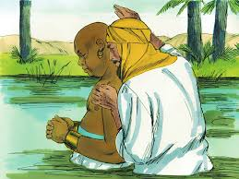
³⁶ As they traveled along the road, they came to some water and the eunuch said, “Look, here is water. What can stand in the way of my being baptized?” ^{[37] [c]} ³⁸ And he gave orders to stop the chariot. Then both Philip and the eunuch went down into the water and Philip baptized him. ³⁹ When they came up out of the water, the Spirit of the Lord suddenly took Philip away, and the eunuch did not see him again, but went on his way rejoicing.
⁴⁰ Philip, however, appeared at Azotus and traveled about, preaching the gospel in all the towns until he reached Caesarea.
Notes:
Leader –
Being led by the Holy Spirit. Read Acts 8 v 26-40 – Phillip and the Ethiopian.
Background – God was using Phillip to spread the Gospel in Samaria – Acts 8 v 4 – 8.
In every way, Phillip was seeing fruit from sharing the Gospel there – lives were being transformed. In today’s language, Phillip was being ‘successful’.
But – Phillip was open to the leading of God’s Spirit – Acts 8 v 26, 27 – ‘so he started out’.
Go through Acts 8 v 26 with your group and see -
God’s guidance
Ethiopian - taken to the scriptures which were explained
The importance of the individual – just one man, on a ‘desert road’
The Ethiopian already has some knowledge – Phillip built on what the Ethiopian knew
Start where people are – not where we think they might be. We need to be able to listen, process what we hear and start with what they know.
(See CYN training power-point on Listening for further help in this area.)

Slide 18
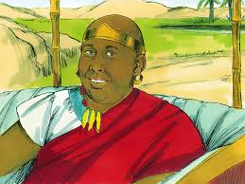
LESSONS TO LEARN FROM ACTS 8
Allow the Lord to guide and move you.
Know and be able to explain the Scriptures.
The importance of the individual.
Start where people are – not where we THINK they might be.
Notes:
Leader –
Read the slide and note that the Ethiopian eventually went to Africa – and the gospel there spread from him.
This illustrates how one person can have an amazing effect through spreading the good news of Jesus. That one could be you and me!

Slide 19

KEY verses - 1 Peter 3 v 15 - 16
¹⁵ But in your hearts set apart Christ as Lord. Always be prepared to give an answer to everyone who asks you to give the reason for the hope that you have. But do this with gentleness and respect, ¹⁶ keeping a clear conscience, so that those who speak maliciously against your good behavior in Christ may be ashamed of their slander.
Notes:
Leader –
Read these verses (or ask someone else to do so) – and think about what God is instructing us to do.
Have Christ at the centre of our thinking and being
Be prepared (also, do our homework) so we are ready to share the answers to the hope we have. Have literature available – perhaps a Pocket Testament League gospel or a Good News newspaper ready with us to give away. (See other CYN training power-point on ‘Using literature in evangelism’)
Gentleness and respect – not being abrasive or unkind, but gentle and encouraging. (We might win an argument, but lose the person!)
In so doing, treating people with gentleness and compassion, we’ll gain respect and a good name – both individually and for our church (v 16).

Slide 20

Adopt a street:
Pray regularly for your own street
Pray for people you already know
in your street
Ensure that your church is praying regularly for your community.
That means getting to know your neighbours and community.
And remember – “If ONE person in the street is a Christian, it should be good news for the WHOLE street”!
Notes:
Leader –
Ask your group to think about where they live – and who they already know in their street.
Pray regularly for your own street – it’s a good idea to walk along your street praying for each household. It’s important to look for opportunities to speak with your neighbours – God will give you opportunities to share about Him.
Pray for people you already know in your street.
Ensure that your church is praying regularly for your community.
To do that effectively – get to know your neighbours and community.
And remember – “If ONE person in the street is a Christian, it should be good news for the WHOLE street”!
(The red cross on the photo illustrates where the Christian lives – praying upward to God for the street, and left, right and across the street for our neighbours.)

Slide 21
FOR MORE INFORMATION AND
GOSPEL LITERATURE PLEASE CONTACT:
www.outreachuk.com
info@outreachuk.com
0300 123 1990
www.goodnews-paper.org.uk
goodnewseditor@ntlworld.com
0115 9233324
www.ptluk.org
admin@ptluk.org
01903 705362
Notes:
Leader -
End of session – I hope you are better prepared to pray for and take the gospel opportunities that God wants to give you and your fellow church members.
Encourage each other by sharing your stories – but be careful about confidentiality.
Don’t be hard or harsh with those who find this difficult, but encourage them to pray for a gospel opportunity each week. (1 Thessalonians 5 v 14 – ‘Encourage the timid, help the weak, be patient with all.’)
(Give opportunity next time you meet to discuss how people got on with this. Don’t be hard on those who struggled, but always encourage them to pray for an opportunity this coming week.)
Leader –
It’s a good idea to always have evangelistic literature available for your church members to use. We would recommend that you order Good News newspapers each month and have a supply of PTL Gospels ready to be given away. Use the details on this slide to get in touch with Good News and PTL. If you want further help in evangelism training, Outreach UK have experienced evangelists available to help and support you – please get in touch using the details above.
Outreach UK has a team of associate evangelists; each pledge to carry out 12 hours evangelism each month – in return, they get support, training and some free resources. If you or someone in your group is interested in knowing more about becoming an Outreach UK Associate Evangelist, please get in touch through the details on the slide, we’d love to hear from you.
May you know God’s blessing and encouragement as you reach out with the Gospel.
End with prayer.

