Slide 1
Evangelism made easy for
everyone.
Notes:
Welcome to ‘Casting Your Nets’.
Casting Your Nets is an initiative between Outreach UK, Good News Newspaper and Pocket Testament League – to enable every Christian to share their faith in Jesus Christ.
You may already be doing that – in which case we pray that this course will encourage, inspire and perhaps, hone your gifts.
Alternatively, you may be coming to this course because you know you should be sharing about your faith in Jesus Christ, but, for some reason, find that impossible or difficult. This course will help you to have more confidence and will show you that, whoever you are, God can and wants to use you to speak about Him.
Each session is both theory and practical – so we encourage you to try putting into practice what you’ve learnt between sessions – and then share about your experiences when you next meet together.
Remember, we are not all the same. We are not all extroverts, or introverts, but we are all brothers and sisters in Christ. Encourage and support each other – and grow in knowing Jesus and sharing about Him.
The Leader –
Prepare by going through each session beforehand.
Make sure the Power-point will play on the equipment you have available.
Have your Outreach UK Evangelism Handbook with you.
Copy the relevant pages from the PDF copy of the Outreach UK Evangelism Handbook so that they are available for each participant – I suggest you give these out at the end of each session.
Each participant will need –
A Bible
A notebook
A pen/pencil
And - be ready to participate.
You may also want to purchase further copies of the Outreach UK Evangelism Handbook for each participant – if so, please contact Outreach UK via info@outreachuk.com or call 0300 123 1990 - we’ll be happy to help you. It is a great resource for every Christian to have and use.

Slide 2
In Partnership with
Notes:
Leader - Three mission organisations working together under ‘Casting Your Nets’ to provide training to make ‘evangelism easy for everyone’.
It’s a good idea to have a look at the Web Site of each organisation – Outreach UK, Good News and Pocket Testament League. This will give you further information about each and what they offer you and your Church.
www.outreachuk.com
www.goodnews-paper.org.uk
www.ptluk.org
LEADER – At the start of this session - Make sure you know which slide relates to each part of this topic in the OUK Evangelism Handbook before leading the session.
The Notes for this training session are found on pages 36 – 38 of the Outreach UK Evangelism Handbook.

Slide 3
MARK 1 v 14 – 15:
¹⁴ After John was put in prison,
Jesus went into Galilee,
proclaiming the good news of God. ¹⁵ “The time has come,”
he said.
“The kingdom of God has come near. Repent and believe the good news!”
Notes:
Leader – Mark 1 v 14, 15 – the message of repentance and believing in Jesus is followed by our commission.
Jesus calls us to follow him – and part of that calling is to share our faith in Him. This is not an optional extra, but for all Christians.

Slide 4
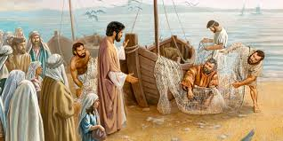
Mark 1 v 17 – 18:
‘Come follow me’, Jesus said, ‘and I will make you fishers of men. At once they left their nets and followed him.’
Notes:
Leader – Mark 1 v 17, 18 – the message of repentance and believing in Jesus is followed by our commission.
We find that the disciples immediately (at once) they left their nets.
This then became the new priority for them – they committed their lives to proclaiming the truth of the gospel.
Thus the Church grew as people put their trust in Jesus as Saviour and Lord.

Slide 5
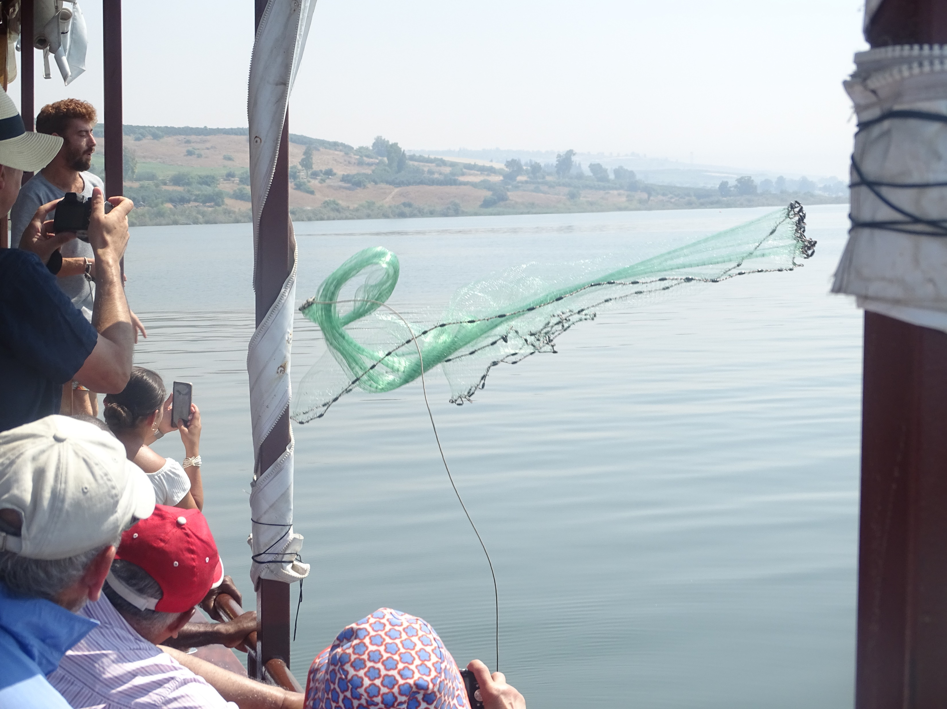
John 21 v 6:
‘Cast your net on the
other side of the boat
and you will find fish’
Notes:
Leader –
The verse from John 21 v 6 – ‘Cast your net on the other side of the boat and you will find fish’ – is the foundation for the ‘Casting Your Nets’ initiative.
It not only encourages and instructs us to fish (for souls in this context) but also to try different ways and different places to catch them.
We need to be proactive in our ‘fishing’ – not passive, just waiting for fish to come to us and jump into the net!
Jesus came to ‘seek and save what was lost’ (Luke 19 v 10).
You may want to read these verses and add your own examples to encourage the need to ‘Go’ with the gospel.
(Photo by kind permission of OUK Evangelist Andy Godfrey, taken on the Sea of Galilee)

Slide 6
Sharing your story
Notes:
Testimony. – Sharing Your Story
This Session is based on the notes on Pages 36 and 37 in the OUK Evangelism Handbook.
Leader -
You might like to share a testimony (true story) at the beginning of this session. It doesn’t have to be ‘Christian’, but something that has happened to you to illustrate telling a story about something that is true.
For example:
Getting married
Your first car
The birth of a baby
When you moved house
Meeting your partner for the first time
Your best life experience.
However, keep it short! No more than a couple of minutes – and then ask for volunteers to do the same.
Now we are ready – into session 1. Testimony

Slide 7
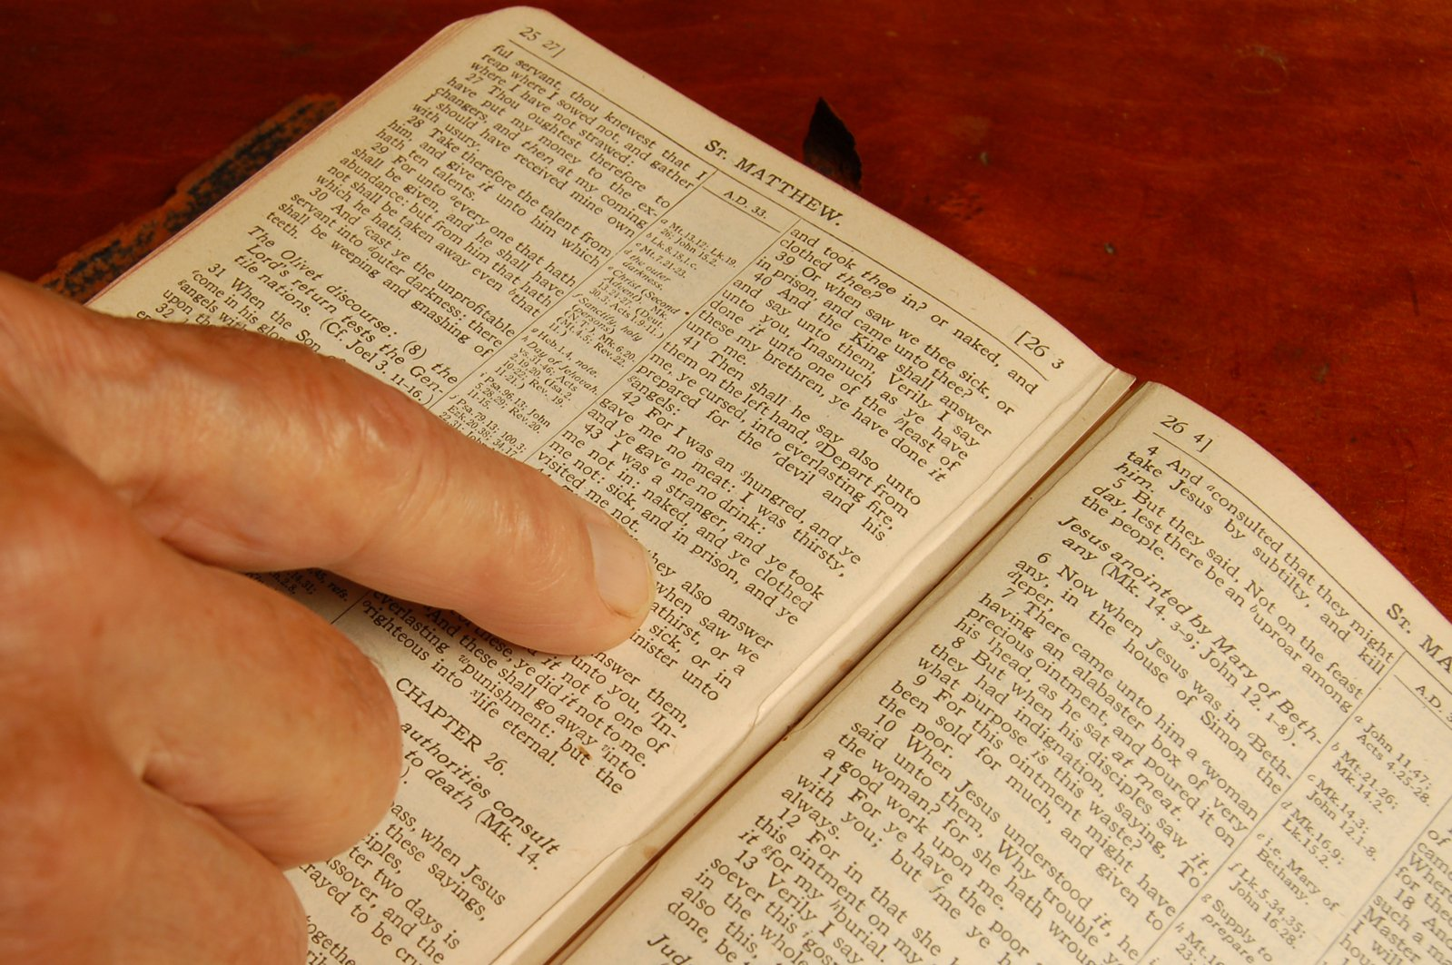
Examples from the Bible …
Mark 5 v 1 – 20
KEY VERSES:
18 - 20
¹⁸ As Jesus was getting into the boat, the man who had been demon-possessed begged to go with him. ¹⁹ Jesus did not let him, but said, “Go home to your own people and tell them how much the Lord has done for you, and how he has had mercy on you.” ²⁰ So the man went away and began to tell in the Decapolis how much Jesus had done for him. And all the people were amazed.
Notes:
See notes in Outreach UK Evangelism Handbook.
Leader’s notes –
Look at:
Mark 5 v 18 - 20 (You could look at Mark 5 v 1 – 20 – for the whole story)
This man wants to tell others about what has happened – ‘So the man went away and began to tell others’ – v 20
He was instructed where to go with his story – ‘in the Decapolis’ – the ten towns. – v 20
He was instructed what to say – ‘how much the Lord has done for you’ – v 19

Slide 8
Examples from the Bible …
John 4 v 39 – 42.
KEY VERSES:
28 – 30 & 39
²⁸ Then, leaving her water jar, the woman went back to the town and said to the people, ²⁹ “Come, see a man who told me everything I ever did. Could this be the Messiah?” ³⁰ They came out of the town and made their way toward him.
³⁹ Many of the Samaritans from that town believed in him because of the woman’s testimony, “He told me everything I ever did.”
Notes:
Leader - Look at:
John 4 – v 39 (You could read verses 28 – 30, v 39 – 42)
Please note v 29 – then, following the woman’s testimony many believed – v 39
The woman’s testimony had an effect on the townsfolk – and helped them believe in Jesus – v 39

Slide 9
Examples from the Bible …
John 9 v 1 – 41
KEY VERSE:
25
²⁵ He replied, “Whether he is a sinner or not,
I don’t know. One thing I do know.
I was blind but now I see!
Notes:
Look at:
In this passage of the Bible, we have a story of a man who was born blind.
John 9 v 25 (Just a one-line testimony)
This is a very short testimony and illustrates that it’s not how long we share for, or even how good we are at sharing our story – but what God does with it.
We are giving witness to God’s work in our lives.

Slide 10
Acts 26
BEFORE – v 1 - 11
DURING v 12 - 18
AFTER – v 19 - 32
Notes:
See notes in OUK Evangelism Handbook – Acts 26, Paul’s Testimony.
Leader -
When looking at Acts 26 – we see how Paul shares his story – check out the relevant verses together.
We can all learn from this way of sharing our story.
There is a pattern to how Paul presents him story which we can learn from.
Before – v 4 - 11
During – v 12 - 18
After – v 19 – 32
Please note - Paul shares his story, but also brings a challenge to Agrippa in verse 27.
It’s good to challenge people to respond to our story about how they will respond themselves.
Paul makes it clear you have to make a decision to become a Christian – we are not born one, or just become one by accident or by someone else’s decision – we need to decide and respond to Jesus call to ‘Follow Him’. As in Acts 26 v 28 – where Agrippa responds to Paul’s challenge.
Leader -
Something for your group: for homework, write out your testimony using the three sections that Paul used – Before, During, After.
Perhaps use about 100 words for – Before
About 300 words for – During
About 100 words for – After
Try and share it with a Christian and then a non-Christian before you next meet up.
(It’s a good idea to keep your testimony short, to the point and using non-church language – words that those who don’t go to church would understand.)
(Leader only - Please note – some of those on this course may not be able to point to a specific time or place of conversion, but have a real knowledge of faith in Christ – thus their ‘Before’ may be very short or almost non-existent, but the testimony should still include repentance and a changed life.)
Before moving on to the next slide, you may like to ask your group if they can suggest advantages of sharing their testimony.
Then, look at those mentioned on the next slide – see if you can add to what’s mentioned there.

Slide 11
TELLING YOUR STORY
ADVANTAGES OF USING A TESTIMONY
People love to hear stories
They demonstrate the reality of Jesus
It avoids arguments
It’s easy to remember
We are sharing truth from experience
It demonstrates the power of the Gospel
It’s biblical and can be very effective
Notes:
Leader – Please use the titles to discuss the points on this slide.
It’s about the power of the Gospel to change lives.
You may like to read – Romans 1 v 16. Paul gives each of us a clear challenge to share our faith in Christ.
People love to hear stories
They demonstrate the reality of Jesus
It avoids arguments
It’s easy to remember
We are sharing truth from experience
It demonstrates the power of the Gospel
It’s biblical and can be very effective

Slide 12
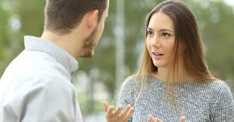
PLACES TO SHARE your story. some suggestions
At invitational events. E.g. men’s breakfast.
In main church services –
have regular testimony slots.
On your church website.
In church welcome packs or booklets.
On a church DVD/CD.
In personal one-to-one witness.
Notes:
Leader – You will note that each example comes up individually.
At invitational events. E.g. men’s breakfast.
In main church services –
have regular testimony slots.
On your church website.
In church welcome packs or booklets.
On a church DVD/CD.
In personal one-to-one witness.
Please give added examples of where, as an individual or church, you could share your story – for example: church BBQs, quiz nights, baptismal services, enquirers courses. Church services - to become more outward looking as a church, it’s good to share testimonies on a regular basis.
Leaders please note that, under personal one2one witness, it’s important to look for natural gospel opportunities, rather than ‘forced’ conversations. We don’t want to impose our faith, but expose it to others.
One of our evangelists prays a simple prayer each day which he’s found God loves to answer: ‘Lord, lead me today to the person you want me to speak to about you.’ God loves to answer this prayer.
We want to respond to God’s opportunities, not ones we’ve just forced or engineered somehow. God is wanting to save people – he wants us to work alongside Him in what he’s doing. This takes the stress out of witnessing – and gives us freedom to be ourselves, used of God and guided by His Spirit (see Philip’s story in Acts 8 v 26 – 40).

Slide 13
Your Story
Will you –
Take the 2 Minute Challenge?
Notes:
Leader -
We recommend that you split people into pairs – then give each person in each pair 2 minutes to share their testimony. Having done that – you might want to ask what people felt about only having 2 minutes to share.
Keep to the 2 minutes for each person – be firm! Don’t let people overrun on their 2 minutes.
Questions to ask
How did each person in your group find sharing their testimony – was it easy, or difficult to remember?
Did anyone get mixed-up, or go off track?
What do you think is the most important point in your testimony – or will this vary according to whom we’re speaking with?
Work though the notes in the Handbook – and point out that it might not be our testimony of how we become a Christian that is most relevant to the person we’re speaking with, but it could be about what God has been teaching me recently, or how He continues to change my life today. Our testimony is always on-going.
You may find when chatting with someone that they share about a personal experience which you can relate to – and share how Jesus has helped you in similar circumstances.

Slide 14
FOR MORE INFORMATION AND
GOSPEL LITERATURE PLEASE CONTACT:
www.outreachuk.com
info@outreachuk.com
0300 123 1990
www.goodnews-paper.org.uk
goodnewseditor@ntlworld.com
0115 9233324
www.ptluk.org
admin@ptluk.org
01903 705362
Notes:
End of session on Sharing your Testimony – well done. We hope you’ll pray for an opportunity to share your story between now and the next session.
Leader -
Possible homework – write out your testimony and share it with a Christian and with a non-Christian.
(Give opportunity next time you meet to discuss how people got on with this. Don’t be hard on those who struggled, but always encourage them to pray for an opportunity this coming week.)
Leader –
It’s a good idea to always have evangelistic literature available for your church members to use. We would recommend that you order Good News Newspapers each month and have a supply of PTL Gospels ready to be given away. Use the details on this slide to get in touch with Good News and PTL. If you want further help in evangelism training, Outreach UK have experienced evangelists available to help and support you – please get in touch using the details above.
Outreach UK has a team of Associate Evangelists, each pledge to carry out 12 hours evangelism each month – in return, they get support, training and some free resources. If you or someone in your group is interested in knowing more about becoming an Outreach UK Associate Evangelist, please get in touch through the details on the slide, we’d love to hear from you.
May you know God’s blessing and encouragement as you reach out with the gospel.
End with prayer.

