Slide 1
Evangelism made easy for
everyone.
Notes:
Welcome to ‘Casting Your Nets’.
Casting Your Nets is an initiative between Outreach UK, Good News Newspaper and Pocket Testament League – to enable every Christian to share their faith in Jesus Christ.
You may already be doing that – in which case we pray that this course will encourage, inspire and perhaps, hone your gifts.
Alternatively, you may be coming to this course because you know you should be sharing about your faith in Jesus Christ, but, for some reason, find that impossible or difficult. This course will help you to have more confidence and will show you that, whoever you are, God can and wants to use you to speak about Him.
Each session is both theory and practical – so we encourage you to try putting into practice what you’ve learnt between sessions – and then share about your experiences when you next meet together.
Remember, we are not all the same. We are not all extroverts, or introverts, but we are all brothers and sister in Christ. Encourage and support each other – and grow in knowing Jesus and sharing about Him.
The Leader –
Prepare by going through each session beforehand.
Make sure the Power-point will play on the equipment you have available.
Have your Outreach UK Evangelism Handbook with you.
Copy the relevant pages from the PDF copy of the Outreach UK Evangelism Handbook so that they are available for each participant – I suggest you give these out at the end of each session
Each participant will need –
A Bible
A notebook
A pen/pencil
And - Be ready to participate

Slide 2
In Partnership with
Notes:
Leader – Three mission organisations working together under ‘Casting Your Nets’ to provide training to make ‘evangelism easy for everyone’.
It’s a good idea to have a look at the Web Site of each organisation – Outreach UK, Good News and Pocket Testament League. This will give you further information about each and what they offer you and your Church.
www.outreachuk.com
www.goodnews-paper.org.uk
www.ptluk.org
LEADER – At the start of this session - Make sure you know which slide relates to each part of this topic in the OUK Evangelism Handbook before leading the session.
Helpful Notes for this training session are found on pages 76, 85 - 89 of the Outreach UK Evangelism Handbook.

Slide 3
MARK 1 v 14 – 15:
¹⁴ After John was put in prison,
Jesus went into Galilee,
proclaiming the good news of God. ¹⁵ “The time has come,”
he said.
“The kingdom of God has come near. Repent and believe the good news!”
Notes:
Leader – Mark 1 v 14, 15 – the message of repentance and believing in Jesus is followed by our commission.
Jesus calls us to follow him – and part of that calling is to share our faith in Him. This is not an optional extra, but for all Christians.

Slide 4
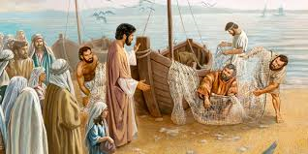
Mark 1 v 17 – 18:
‘Come follow me’, Jesus said, ‘and I will make you fishers of men. At once they left their nets and followed him.’
Notes:
Leader – Mark 1 v 17, 18 – the message of repentance and believing in Jesus is followed by our commission.
We find that the disciples immediately (at once) they left their nets.
This then became the new priority for them – they committed their lives to proclaiming the truth of the gospel.
Thus the Church grew as people put their trust in Jesus as Saviour and Lord.

Slide 5
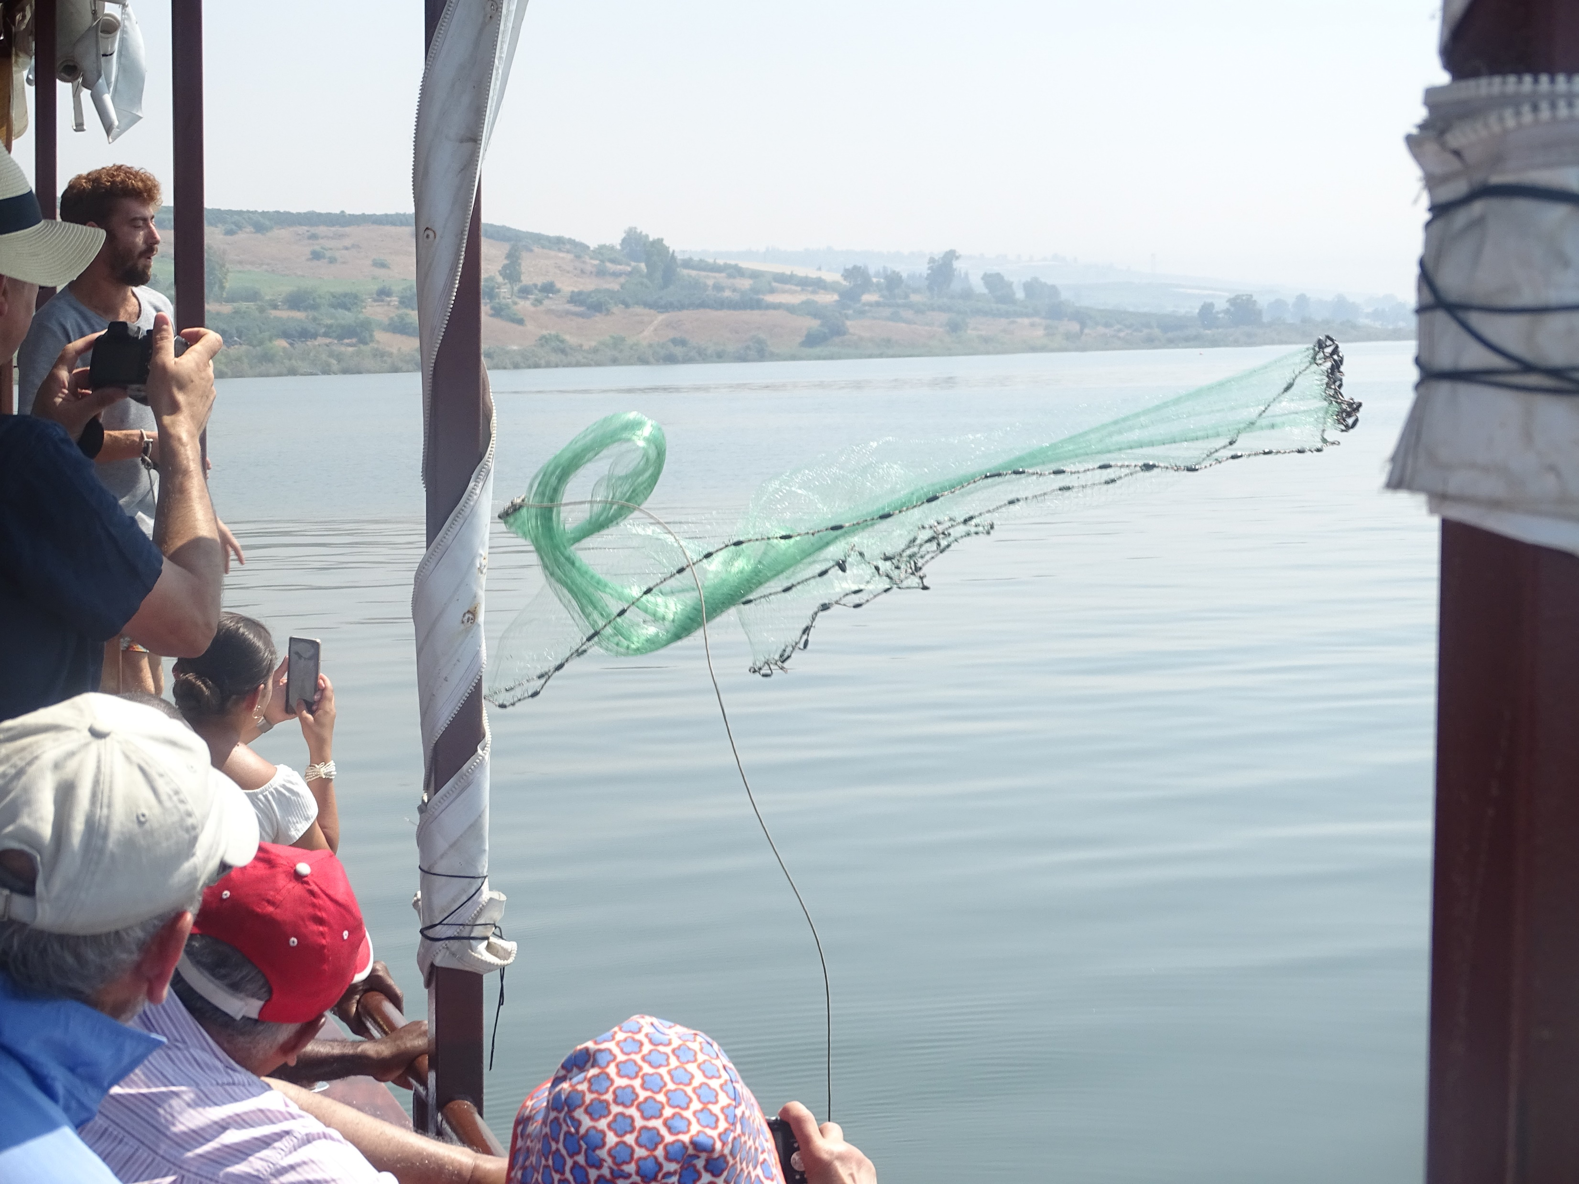
John 21 v 6:
“Cast your Net on the
other side of the boat
and you will find fish”.
Notes:
Leader – Background information.
The verse from John 21 v 6 – ‘Cast your net on the other side of the boat and you will find fish’ – is the foundation to the ‘Casting Your Nets’ initiative. It not only encourages and instructs us to fish (for souls in this context) but also to try different ways and different places to catch them. We need to be proactive in our ‘fishing’ – not passive, just waiting for fish to come to us and jump into the net! Jesus came to ‘seek and save what was lost’ (Luke 19 v 10)
You may want to read these verses and add your own examples to encourage the need to ‘Go’ with the gospel.
(Photo by kind permission of Andy Godfrey (OUK Evangelist) taken on the Sea of Galilee)

Slide 6
Using literature
in evangelism
Notes:
Leader – You may want to have a brief re-cap on any previous sessions and any ways your group have applied the training. (Don’t spend too much time on this, but it’s good to encourage all course members to share if possible – or get into groups to share)
Leader - Tools to help us with our evangelism.
We’ve included two different evangelism tools – Good News Newspapers and Pocket Testament League Gospels.
There are many others, but these two have been widely used and are effective in sharing the good news of Jesus Christ. See your additional Notes provided for this topic. You will also find further help on https://www.goodnews-paper.org.uk/ and https://www.ptluk.org/
We suggest that you obtain copies of each before running the session. Make sure you have enough copies for each participant and extra copies for each person to give away to a non-believer before this training session.
As part of the ‘Casting Your Nets’ initiative your group members can each receive a free copy of both a Good News Newspaper and PTL Gospel – please advise Outreach UK (www.outreachuk.com – or call them on 0300 123 1990) of your participation in this course and by each participant filling in the CYN blue leaflets provided – these samples will then be posted to you, Free of Charge. (Other copies you order will need to be paid for.)
The Good News Newspaper is a monthly tabloid style evangelistic newspaper with something for everyone. When was the last time you saw a newspaper that had nothing but good news? The paper contains powerful testimonies, true life stories, film reviews, and sports articles all with a gospel emphasis. Items such as the cross word and recipe are designed to create opportunities for conversation and friendship.
One Church uses the crossword as a means to encourage spiritual conversations by everybody working together at the Church coffee morning to complete the puzzle. In order to find some of the answers to the crossword you’ll need to open a Bible.
The paper contains a response form entitled “How to know Jesus for yourself” which can be returned directly to Good News. In return a free gospel and DVD (entitled “Who is Jesus”) will be sent out.

Slide 7
WHO DO YOU MEET & WHERE DO YOU GO?
Placed in Doctors and Dentist’s waiting rooms. Staff rooms and university common rooms.
Street outreach. Given to Taxi Drivers.
Distributed through Church bookstalls, coffee shops, charity shops and market stalls.
…….
Notes:
Leader – Ask your group as to where they go and who they meet where they might be able to give away either a Good News Newspaper or Pocket Testament League Gospel.
You’ll already have heard from your group re places they visit and about people they meet – and could use these as opportunities to give away Good News Newspapers and PTL Gospels – Here are a few to add to your groups suggestions, perhaps some you’ve not thought of. This list is not meant to be exhaustive!

Slide 8
WHO DO YOU MEET & WHERE DO YOU GO - continued
Placed in local libraries, shops, prisons &
hospices.
Given to visitors at Church services.
Distributed at Parents and Tots groups, men’s groups & youth groups.
Personal Contacts.
Door to door work.
People who come to our homes.
Notes:
Leader –
Even Christians who are housebound have opportunities to share the gospel.
For example - PEOPLE WHO COME TO THEIR HOMES – Delivery drivers, postmen, workmen, J.Ws., careers, gardeners etc.
Some may also like to post copies of the Gospels or GNP to others.
We are God’s People who have God’s Seed to sow – Where is your field of opportunity? Be open to how God will lead you by His Spirit and through prayer.

Slide 9
Some Advantages of Using the Good News Paper
Professional Evangelistic Resource
Inexpensive
Mobilises others in the church
Keeps outreach on the church agenda
Non threatening approach
Builds contacts & relationships
Helps to lead into spiritual conversations
People are converted
Notes:
Leader -
Question to ask?
What do you think are the advantages of reading a News Paper? (Around 75,000 copies of GNP are distributed every month)
(For example, The Sun distributes about 1.2 Million copies each month, with the daily Mail about 1.1 Million and the Daily Express about 300,00 copies (2019 figures) The Metro is about 1.4 Million/month.)
At only 15p per copy it is inexpensive compared to buying tracts and gospel booklets. 25 copies (which is the minimum order) cost = £7.35 delivered. 100 copies costs £22 delivered, and 200 copies cost £37 delivered to your door. (Check as costs may change)
Bespoke copies can also be ordered – but with minimum quantities and a small extra cost.
For example - London City Mission have a bespoke copy called ‘Good News for London’
These help church members to be involved in outreach. Encourage members to buy papers to distribute to their own contacts
Really important – not just a one off outreach event but month by month – consistency matters.
Non threatening – easy to hand a free paper to someone – ‘I’ve just brought you some Good News – now that makes a change!!’
It’s a great way to get to know people in the community – with regular monthly visits.
Develops spiritual interest and gives opportunity for gospel witness, and possible invites to Alpha, Christianity Explored Courses.
Encourage each Church Member to take one copy for themselves – and one to give away. When they’ve read their own copy, look to give that one away too. Many in our churches can get involved with this type of evangelism by doing this.

Slide 10
Things to remember:
Have regular corporate prayer for the distribution of the papers.
Have regular feedback – share encouraging stories with each other.
Ensure every paper has a name and contact details on it.
Keep praying for this ministry on a regular basis
Notes:
Leader – Emphasize the need for contact details to be on each paper. This is really important – but be careful about putting a home phone number or address, just in case someone wants to be a nuisance!! (Some just put the Church address and website details – along with a ‘spare’ mobile phone number). Please make sure these details are kept up to date – including times of meeting and Church events. A good ‘Point of Contact’ is vital.

Slide 11
THINGS TO REMEMBER..
Insert leaflets advertising Church events and enquires courses.
Read the paper yourself before handing it out.
Have realistic expectations about the results.
Notes:
Leader –
Ask your Group – What events, Courses or other Church activities could we advertise through putting fliers in Good News Newspaper?
It’s very important to have read the GNP before you hand it out – firstly, you’ll know what’s in it if someone asks you. Secondly, you might be able to suggest an article to someone if, by chatting with them, you find they have a particular interest. For example – gardening, or sport, or crosswords.
(Illustration – a workman took a GNP when he heard it has Sudoku in it – it was the only think he was interested in. A few weeks later, the same workman took the Paper again and this time was noticed reading the sports page.)
Leader – The Papers are very much a sowing exercise – thus you need to have realistic expectations. Perhaps look at the parable of the sower – Mark 4. This saves us from getting discouraged and giving up.

Slide 12
The pocket testament league gospels
Notes:
(Further notes on pages 30 – 41 in the Outreach UK handbook)
Pocket Testament League was founded in 1863 by 16 year old Helen Cadbury whose desire was that everyone should be able to read a portion of the Bible. She, along with other ladies, sowed pockets into they dresses or skirts so as to carry a Gospel – to give away.
From those small beginnings Millions of Gospels have been given away and it’s grown into a world-wide ministry with in excess of 500,000 members, distributing over 10,000,000 Gospels each year.
In the UK PTL are looking to recruit over 100,000 volunteers to carry, read and share these Gospels.
PTL offer really good training resources to anyone who sign’s up to this vision. These Gospels cost around 50p each, but if you or your Church find this prohibitive, Gospels can be ‘Sponsored’ by someone else so you can have them free. If your finances allow, you might like to ‘sponsor’ some for others to give away free.
Leader –
Ask your group to think about where they might go each week and to think about possible openings and opportunities to give away either a Good News Newspaper, of a PTL Gospel
Now move on to the next slide.

Slide 13
“Love is the bridge”
Notes:
Leader –
‘Love is the bridge’ has a very clear, simple and easy to use explanation of the Gospel.
Show your group the illustration in your Gospels, then break your group into pairs so that each person has 2 minutes to share the ‘Bridge’ illustration of the gospel with their partner. It’s easy to do if you start with your finger in the right page to get you started. In some Gospels the illustration is at the beginning of the Gospel, in others, at the end.
Encourage everyone to get into pairs and, using the ‘Bridge illustration’ in the PTL Gospel, share the gospel message using ‘non-Christian’ language, by this we mean, using every-day language rather than the types of words we often use in our Churches or to express our faith.
Christians often use words/churchy language which those outside the Church don’t understand – thus we need to be ready to change the words we use, or, at the least, be able to explain what we mean.
Exercise - What other words could we use instead of -
Saved (surrender)
Sin (principle of self-rule, selfishness or rebellion, missing the mark) (The arrow has missed the mark)
Repentance Turn around, change your values)
Kingdom (God’s rule)
Sanctification (clean; walking free or make holy)
Conversion (new start; seeing the world in a new way)
Add your own examples – and words you could use as substitutes.
(See Grove Publication Ev 100 – Evangelism by Laurence Singlehurst)

Slide 14
Read
Carry
Share
Notes:
Leader – We have the encouragement and can see how importance it is to –
Read our Bibles on a daily basis and also the Gospel Outline.
Carry a Gospel to give away – and pray about who to give it to.
Be ready to Share the Gospel with those we meet – and pray for them.
All three are good disciplines for our ongoing spiritual health and growth.
These three elements remind us of what we can do to spread the gospel – READ, CARRY, SHARE
The next time you meet up as a group, why not ask how each are getting on with giving away the Gospels?
Testimony – ‘On walking through the Station concourse, I had ready in my hand a ‘Booklet about the life of Jesus’. The young man sitting on the bench readily accepted it when offered – and after a short conversation said he’d read it and thanked me for giving the Gospel to him.’

Slide 15
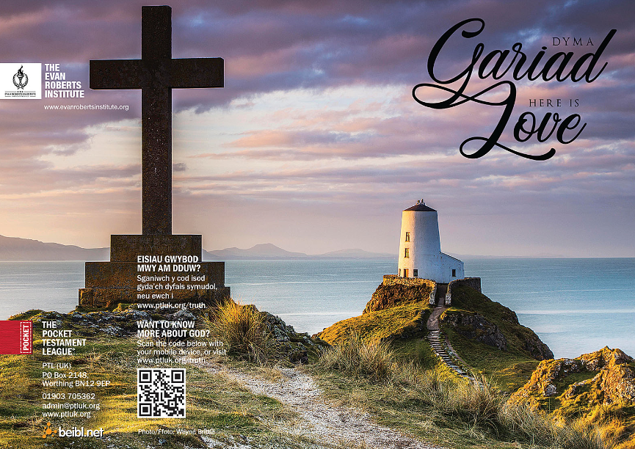
Examples of OTHER P.T.L. GOSPELS.
Notes:
Leader –
Your Gospels can be customised – bespoke for you and your Church.
There are Gospels available in various languages – get in touch with PTL for further details re personal covers and languages.
There is a QR Code – which leads to a really good, helpful gospel outline.
There is also an ‘interactive Gospel’ – which has a video to watch after each chapter.

Slide 16
UNIQUE evangelistic opportunities.
Others
I.E.
Hairdressers
Shop staff
Post Workers
Family
Neighbours
Students
Friends
ME
Hobbies
Work
Church
fringe
Notes:
Leader – please note this slide is designed to be printed so that each member of your group can have a copy. encourage them to fill this in. This will show how many contacts each already has – thus opportunities to share the gospel.
Encourage your group to put names in the different boxes – so that those people can be prayed for and opportunities sort to share the gospel with through word of mouth and literature. Pray for a ‘Gospel’ opportunity each day.

Slide 17
FOR MORE INFORMATION AND
GOSPEL LITERATURE PLEASE CONTACT:
www.outreachuk.com
info@outreachuk.org
0300 123 1990
www.goodnews-paper.org.uk
Mandy-goodnews@ntlworld.com
0115 9233324
www.ptluk.org
admin.ptluk.org
01903 705362
Notes:
Leader –
This is the end of this teaching session on using Literature in evangelism.
It’s a good idea to always have evangelistic literature available for your Church Members to use. We would recommend that you order Good News Newspapers each month and have a supply of PTL Gospels ready to be given away. Use the details on this slide to get in touch with Good News and PTL. If you want further help in evangelism training, Outreach UK have experienced evangelists available to help and support you – please get in touch using the details above.
Outreach UK has a team of Associate evangelists, each pledge to carry out 12 hours evangelism each month – in return, they get support, training and some free resources. If you or someone in your group is interested in knowing more about becoming an Outreach UK Associate Evangelist, please get in touch through the details on the slide, we’d love to hear from you.
May you know God’s blessing and encouragement as you reach out with the gospel.
End with prayer.

