Slide 1

Evangelism made easy for
everyone.
Notes:
Welcome to ‘Casting Your Nets’
Leaders’ Notes –
Casting Your Nets is an initiative between Outreach UK, Good News Newspaper and Pocket Testament League – to enable every Christian to share their faith in Jesus Christ.
You may already be doing that – in which case we pray that this course will encourage, inspire and perhaps, hone your gifts.
Alternatively, you may be coming to this course because you know you should be sharing about your faith in Jesus Christ, but, for some reason, find that impossible or difficult. This course will help you to have more confidence and will show you that, whoever you are, God can and wants to use you to speak about Him.
Each session includes both theory and practical – so we encourage you to try putting into practice what you’ve learnt between sessions – and then share about your experiences when you next meet together. We don’t want to condemn any who find evangelism difficult (many Christians do), but support and help each other to become better at sharing our faith in Jesus Christ.
Remember, we are not all the same. We are not all extroverts, or introverts, but we are all brothers and sister in Christ. Encourage and support each other – and grow in knowing Jesus and sharing about Him.
The Leader – (This is very important!)
Prepare by going through each session beforehand.
Make sure the Power-point will play on the equipment you have available. If you are leading the course via Zoom – make sure you know how to ‘share your screen’ – so that others can see the Power-point slides.
Have your Outreach UK Evangelism Handbook with you.
Copy the relevant pages from the PDF copy of the Outreach UK Evangelism Handbook so that they are available for each participant – I suggest you give these out at the end of each session – ready for the next session. Alternatively, each participant may want to buy their own copy of the Manual – and get all the training notes it contains. Contact Outreach UK via – info@outreachuk.com - or by calling 0300 123 1990.
Each participant will need –
A Bible
A notebook
A pen/pencil
And - be ready to participate – but don’t force those who are shy, but encourage each one to see they have something to contribute.

Slide 2



In Partnership with
Notes:
Leader - Three mission organisations working together under ‘Casting Your Nets’ to provide training to make ‘evangelism easy for everyone’.
It’s a good idea to have a look at the website of each organisation – Outreach UK, Good News and Pocket Testament League. This will give you further information about each and what they offer you and your Church.
www.outreachuk.com
www.goodnews-paper.org.uk
www.ptluk.org
LEADER – At the start of this session - Make sure you know which slide relates to each part of this topic in the OUK Evangelism Handbook before leading the session.
Please read Pages 51 – 59 in your OUK Evangelism Handbook

Slide 3

MARK 1 v 14 – 15:
¹⁴ After John was put in prison,
Jesus went into Galilee,
proclaiming the good news of God. ¹⁵ “The time has come,”
he said.
“The kingdom of God has come near. Repent and believe the
good news!”
Notes:
Leader - Mark 1 v 14 - 20 reminds everyone that Jesus calls each of us to become ‘Fishers of Men’ – to share about our own personal relationship with Jesus Christ as Saviour and Lord.
Please read Mark 1 v 14 – which reminds us of the need to repent and believe the good news. The follower of Jesus becomes a ‘fisher of men’. It is what each Christian is called to be.

Slide 4
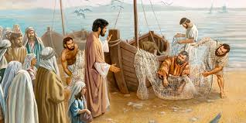

Mark 1 v 17 – 18:
‘Come follow me’, Jesus said, ‘and I will make you fishers of men. At once they left their nets and followed him.’
Notes:
Leader – Mark 1 v 17, 18 – the message of repentance and believing in Jesus is followed by our commission.
We find that the disciples immediately (at once) left their nets.
This then became the new priority for them – they committed their lives to proclaiming the truth of the gospel.
Thus the Church grew as people put their trust in Jesus as Saviour and Lord.

Slide 5
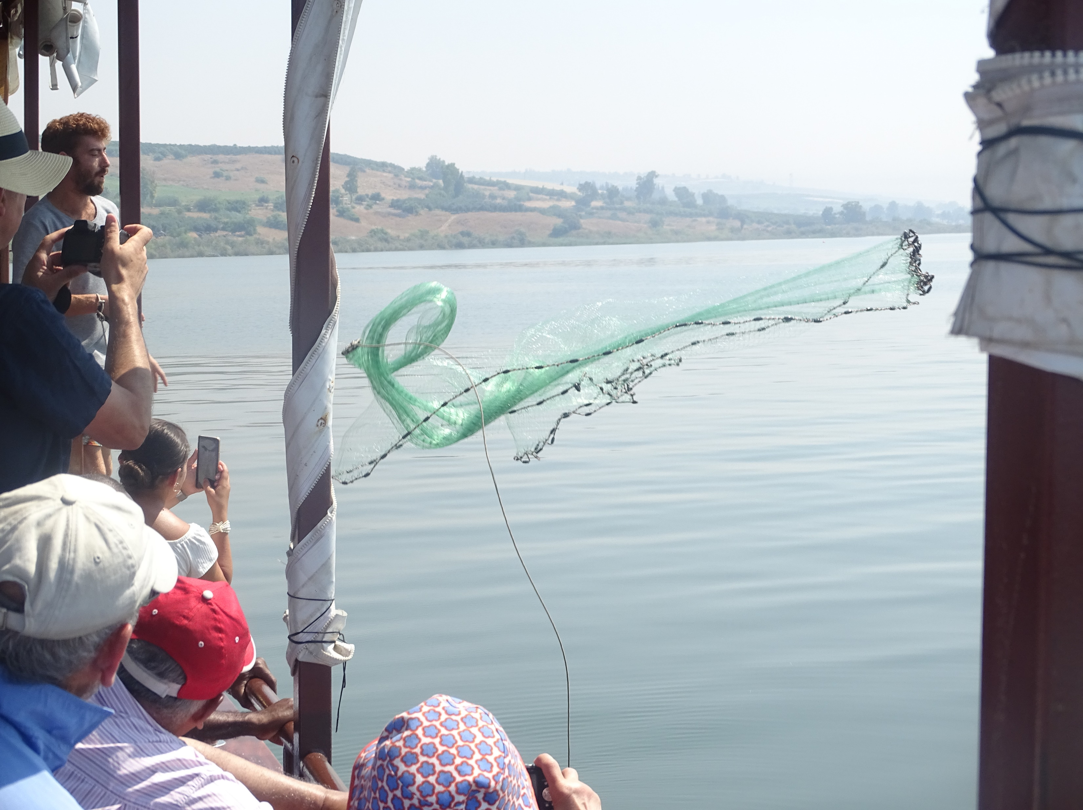

John 21 v 6:
‘Cast your net on the
other side of the boat
and you will find fish’
Notes:
Leader – The verse from John 21 v 6 – ‘Cast your net on the other side of the boat and you will find fish’ – is the foundation to the ‘Casting Your Nets’ initiative. It not only encourages and instructs us to fish (for souls in this context) but also to try different ways and different places to catch them. We need to be proactive in our ‘fishing’ – not passive, just waiting for fish to come to us and jump into the net! Jesus came to ‘seek and save what was lost’ (Luke 19 v 10).
You may want to read these verses and add your own examples to encourage the need to ‘Go’ with the gospel.
(Photo by kind permission of Andy Godfrey (OUK Evangelist) taken on the Sea of Galilee.)

Slide 6

LISTENING
Notes:
The notes for this session are found on pages 51 – 59 of the Outreach UK Evangelism Handbook.
This session is focused on listening.
Leader -
You might like to share a testimony at the beginning of this session. It doesn’t have to be ‘Christian’, but something that has happened to you to illustrate telling a story about something that is true.
For example:-
Getting married
Your first car
The birth of a baby
Where you used to live
Meeting your partner for the first time
Your best life experience
Only spend a couple of minutes on your story
At the end of this session, you could ask people what they remember of what you shared now. It’s not just a memory exercise, but did they listen???

Slide 7

The Importance of Listening
Ecclesiastes 3 v 7
Notes:
Leader - Each person will need paper and something to write with.
A listening exercise: 7 Questions –
These questions are designed to test our listening skills. It’s really important that you only ask the questions once and never repeat them, even when asked to do so (which someone is bound to do!).
The questions are designed to be both fun and testing. Everyone will get at least one question wrong because they didn’t listen properly! It’s FUN, but also SERIOUS!
(You could leave giving the answers to these question until later in this session – it breaks thing up a bit and generally makes the point that we all mis-hear sometimes and thus may miss the most important thing that has been said.)
7 Questions to ask – (remember, only ask them once and never repeat them!)
Do they have a 5th of November in America?
How many months of the year have 28 days?
If you only had one match and entered a dark room with an oil lamp, kindling wood and a candle, what would you light first?
If the Doctor gave you three pills and said take one every half hour, how long would it take to take them all?
You have 17 sheep, but following a storm, all but nine of them have died. How many do you have left?
You take 2 apples from a pile of five. How many apples do you have?
How many animals of each species did Moses take into the Ark?
LEADER - Please note – the answers will be given after slide 11
It’s an important aspect of evangelism to know when to speak and when to listen. We often use questions in evangelism so it’s important to listen carefully to the replies given.
If you ask the question “what is a Christian?” many will reply “it is somebody who goes to church, or someone who lives a good life” but we know the true answer is that it’s someone who has a personal relationship with Jesus Christ.
If we listen well to what people say – we will understand more fully how they think and what they believe – therefore it is to our advantage when we want to know how to witness to them.

Slide 8

What’s the difference between listening
and hearing?
‘Therefore consider carefully how you listen’ – Luke 8 v 18
Notes:
LEADER –
Ask your group this question - What’s the difference between listening and hearing? Give time for people to answer or discuss this. Is there a difference?
See page 51 in the OUK Evangelism Handbook
Lets look together at Luke 8 v 18. Jesus says ‘Therefore consider carefully how you listen …’
The point is - Listening is wanting to hear. It’s a bit like when your wife/husband says to you “You are not listening are you”?
See next slide for the biblical reference – from different Bible translations.

Slide 9

POOR LISTENING HABITS
BEING IN A HURRY
NOT PAYING ATTENTION
CONSTANTLY INTERRUPTING
FEELING DEFENSIVE OR GUILTY
……………..
Notes:
We are reminded here of poor listening habits – of which we are all guilty.
BEING IN A HURRY
NOT PAYING ATTENTION
CONSTANTLY INTERRUPTING
FEELING DEFENSIVE OR GUILTY
Perhaps there are others which your group can add to this list. What might those be?

Slide 10
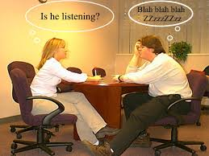
POOR LISTENING HABITS
HAVING PRECONCEIVED IDEAS OF WHAT THE OTHER PERSON WILL SAY
WANTING TO OFFER ADVICE OR SOLUTIONS
Notes:
Leader – the slide illustrates some poor listening habits:
1. Having preconceived ideas of what the other person will say
2. Wanting to offer advice or solutions (when all the other person wants is to be listened to so they can work out their own solutions).
As a group, you may want to think about other poor listening habits – adding to those suggested.
Has anyone in your group experienced this – or been the one to offer advice and solutions, when all that was needed was for the person to be listened to?
Leader – you may want to ask your group, ‘What are the characteristics of a good listener?’ – before moving on to the next slide.
Now move on -

Slide 11

EFFECTIVE LISTENERS ARE
ATTENTIVE – Giving undivided attention
PATIENT – Not interrupting
AWARE – of body language
NOT AFRAID TO CLARIFY – Establishing true understanding
GENUINE
PEOPLE WHO CAN KEEP CONFIDENCES
Notes:
See page 52 OUK Evangelism Handbook
Effective Listeners – this is what we want to aspire to.
Attentive
Patient
Aware
Not afraid to clarify
Genuine
People who can keep confidences
Dictionary -
Listen – Make effort to hear something
- Hear with attention
- Give attention with ear
Good listener – one who habitually listens with interest or sympathy
LEADER - Now let’s have a look at the answers to our ‘Listening Exercise’ – how well did we score?
Answers –
Do they have a 5th of November in America? – answer – Yes, all countries have a 5th of November (but not quite like ours in UK – Bonfire Night!)
How many months of the year have 28 days? – answer – All months have 28 days (and some have more!)
If you only had one match and entered a dark room with an oil lamp, kindling wood and a candle, what would you light first? – answer – light the match
If the doctor gave you three pills and said take one every half hour, how long would it take to take them all? – answer – one hour – i.e. – first pill at 2pm, second at 2.30pm, the third at 3pm
You have 17 sheep, but following a storm, all but 9 of them have died. How many do you have left – answer – 9 sheep left
You take two apples from a pile of five. How many apples do you have? – answer – you have two apples
Lastly, how many animals of each species did Moses take into the Ark? – answer – none, Moses wasn’t there!
Leader – Ask your group -
How well did we ‘score’ with our listening habits? Is there room for improvement?
Although this is a fun quiz, it may well show how we can all jump to wrong conclusions because we haven’t listened properly.

Slide 12

Shush – Don’t interrupt!
Notes:
Leader -
Question to ask?
What habits in others frustrate us when we want to unburden ourselves to them?
Do we also have bad listening habits ourselves?
Be honest!

Slide 13

SKILL
WAKING HOURS COMMUNICATION
LISTENING
TALKING
READING
WRITING
40%
35%
16%
9%
Notes:
Leader –
Question to ask:
How do we spend our days? What time do we give to –
SKILL Waking Hours in Communication
Listening 40%
Talking 35%
Reading 16%
Writing 9%
This will vary for each person – so these figures are averages

Slide 14
COMMUNICATION
Words – 7%
Body language – 55%
Tone of voice – 38%
Notes:
See page 53 OUK Evangelism Handbook
Leader -
Question to ask:
How can we tell whether others are for us or against us, apart from what they say?
What is good body language? Discuss.
What is bad body language? Discuss.
Body language = 55%
Tone of voice = 38%
Words = 7%

Slide 15
Listening skills in evangelism
Sharing your faith without an argument
What kind of spiritual beliefs do you have?
To you, who is Jesus?
Do you think there is a heaven and a hell?
If you were to die tonight, where would you go?
If what you believe were not true, would you want to know?
Notes:
Leader –
See notes on pages 39 in OUK Evangelism Handbook.
We need to listen carefully to how people answer these questions before we then think about how we might share the truths of the gospel with them. We might need to use follow-up questions to find out more, for example –
To you who is Jesus – the response was, ‘An alien’ – the person was then asked ‘Why do you believe that’? – their response was ‘Jesus had to have come from somewhere else to do the miracles he did. He wasn’t an ordinary man’ This reveals that it wasn’t such a silly response as first seemed.
Someone may share quite a lot – we must learn to give people time and space to share what they want to before we then speak ourselves.
(Look out for Randy Newman Book ‘Questioning Evangelism)

Slide 16

Ask the right questions
To you who is Jesus?
How much of the bible have you read?
What spiritual beliefs do you have?
What happens after death?
What is the main thing that convinced you to believe what you believe?
Notes:
Leader -
Question to ask.
What questions could we ask to help steer a conversation towards Jesus?
What is the most important message to share?
What Bible verses encourage us to point people to Jesus – look at Romans 1 v 16.
What was Paul’s goal?
What was Paul aiming at doing?
What are we aiming at, what’s our goal?
1 Peter 3 v15 – ‘But in your hearts set apart Christ as Lord. Always be prepared to give an answer to anyone who asks you to give the reason for the hope that you have. But do this with gentleness and respect.’
How can we encourage others to share their ideas, thoughts and feelings with us?
What questions might we use?
Jesus often asked questions – such as, Mark 8 v 27 – ‘Who do people say I am?’
Leader – Look up other verses to illustrate Jesus using questions.
Or you may want to ask your group to find other examples of Jesus using questions.
We also need to remember what Peter says in 1 Peter 3 v 15 – ‘Always be prepared to give an answer to everyone who asks you to give the reason for the hope that you have. But do this with gentleness and respect.’ The only Christian book that some will read – is me and you! We always want to leave a conversation with that person wanting to know more about our faith. We may win an argument, but lose the person.
A really good book on this topic is ‘Questioning Evangelism’ by Randy Newman (Kregel Publications)
Also – ‘Intentional’ – By Paul Williams – from www.10ofthose.com

Slide 17

I see ……
You acknowledge
what’s been said
Notes:
Leader -
Question to ask:
We may need to clarify what has been said. Perhaps ask the question, “Let me see if I have got this right…”
How do you think the person you are talking to feels about the way we have listened and responded to what they have said?
We want them to know that they have been listened to and understood, even though we may disagree with what they have said.
How do you feel when you’ve been listened to?

Slide 18


Our aim -
JESUS
Notes:
Leader -
Question to ask. Through your evangelism, what are we wanting to achieve?
Is this target/goal realistic?
Is it something we can have control over?
How might prayer come into this ‘aim’/goal?
Please note – Evangelism is not just inviting someone to a Church Service – Evangelism must include the ‘Evangel’ – the Good News about Jesus Christ and salvation through knowing Him as Saviour and Lord.

Slide 19

Keep your eye on the goal
Notes:
Leader – Our goal is always to show people what the Bible teaches about Jesus and other faith questions, and how we can have a relationship with him as Saviour and Lord.

Slide 20
Will YOU now be a better listener?
Notes:
Leader -
Question to ask:
At the end of this session ask - How important is listening to sharing our faith in Jesus?
What were the main points in the story I told at the beginning? Has anyone listened?!
Suggested Reading – A really good book on this topic is ‘Questioning Evangelism’ by Randy Newman (Kregel Publications)
Also – ‘Intentional’ – By Paul Williams – from www.10ofthose.com

Slide 21
FOR MORE INFORMATION AND
GOSPEL LITERATURE PLEASE CONTACT
www.outreachuk.com
info@outreachuk.com
0300 123 1990
www.goodnews-paper.org.uk
Mandy-goodnews@ntlworld.com
0115 9233324
www.ptluk.org
admin@ptluk.org
01903 705362
Notes:
Well done for completing this session.
Leader – For homework - this week, try and see how we might be able to use our listening skills to advance sharing the gospel – and be ready to share next time with our successes and, our struggles. We are all learning – and will keep learning as we refine our skills and God-given abilities and as He continues to teach and hone us.
Leader –
It’s a good idea to always have evangelistic literature available for your church members to use. We would recommend that you order Good News Newspapers each month and have a supply of PTL Gospels ready to be given away. Use the details on this slide to get in touch with Good News and PTL. If you want further help in evangelism training, Outreach UK have experienced evangelists available to help and support you – please get in touch using the details above.
Outreach UK has a team of Associate evangelists, each pledge to carry out 12 hours evangelism each month – in return, they get support, training and some free resources. If you or someone in your group is interested in knowing more about becoming an Outreach UK Associate Evangelist, please get in touch through the details on the slide, we’d love to hear from you.
May you know God’s blessing and encouragement as you reach out with the gospel.
End with prayer.

