Slide 1

Evangelism made easy for
everyone.
Notes:
Welcome to ‘Casting Your Nets’.
Casting Your Nets is an initiative between Outreach UK, Good News Newspaper and Pocket Testament League – to enable every Christian to share their faith in Jesus Christ.
You may already be doing that – in which case we pray that this course will encourage, inspire and perhaps, hone your gifts.
Alternatively, you may be coming to this course because you know you should be sharing about your faith in Jesus Christ, but, for some reason, find that impossible or difficult. This course will help you to have more confidence and will show you that, whoever you are, God can and wants to use you to speak about Him.
Each session is both theory and practical – so we encourage you to try putting into practice what you’ve learnt between sessions – and then share about your experiences when you next meet together.
Remember, we are not all the same. We are not all extroverts, or introverts, but we are all brothers and sisters in Christ. Encourage and support each other – and grow in knowing Jesus and sharing about Him.
The Leader –
Prepare by going through each session beforehand.
Make sure the Power-point will play on the equipment you have available.
Have your Outreach UK Evangelism Handbook with you.
Copy the relevant pages from the PDF copy of the Outreach UK Evangelism Handbook so that they are available for each participant – I suggest you give these out at the end of each session.
Each participant will need –
A Bible
A notebook
A pen/pencil
And - be ready to participate.
You may also want to purchase further copies of the Outreach UK Evangelism Handbook for each participant – if so, please contact Outreach UK via info@outreachuk.com or call 0300 123 1990 - we’ll be happy to help you. It is a great resource for every Christian to have and use.

Slide 2



In Partnership with
Notes:
Leader - Three mission organisations working together under ‘Casting Your Nets’ to provide training to make ‘evangelism easy for everyone’.
It’s a good idea to have a look at the website of each organisation – Outreach UK, Good News Newspaper and Pocket Testament League. This will give you further information about each and what they offer you and your Church.
www.outreachuk.com
www.goodnews-paper.org.uk
www.ptluk.org
LEADER – At the start of this session - Make sure you know which slide relates to each part of this topic in the OUK Evangelism Handbook before leading the session.
Please read Pages 51 – 59 in your OUK Evangelism Handbook

Slide 3
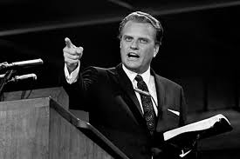
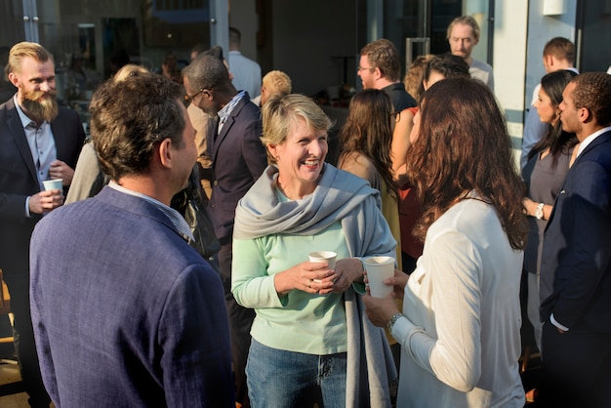

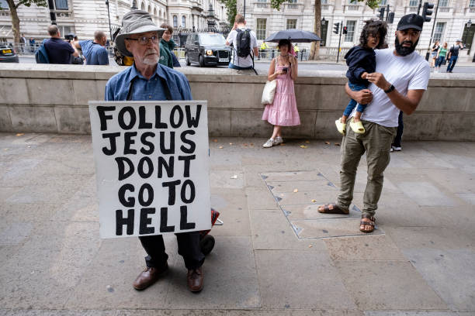
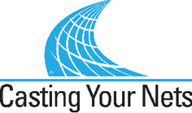
DIFFERENT EVANGELISTIC STYLES ……
Notes:
Lets just take a moment to pause and define exactly what we mean by Evangelism. The Bible simply defines it as spreading the good news. We can’t convert anyone but we can and should share Jesus with them. We plant the seed but God waters it and brings growth. Of course we back up everything with prayer. Here is my favorite definition of evangelism…. Next slide! (Add scripture reference here – ‘One plants, another sows, but God gives the increase’ – 1 Cor 3 v 6)

Slide 4
DEFINING EVANGELISM…
‘One beggar telling another beggar where to find bread’ – C H Spurgeon
(kindness and generosity)
‘For out of the overflow of the heart, the mouth speaks’ – Matthew 12 v 34
(Overflow)
‘To evangelise is to present Jesus Christ in the power of the Holy Spirit, that men shall come to put their trust in God through Him, to accept Him as Saviour, and serve Hin as their King, in fellowship with His Church’ – Archbishop William Temple (Jesus Focused)
Notes:
Lets just take a moment to pause and define exactly what we mean by Evangelism. The Bible simply defines it as spreading the good news. We can’t convert anyone but we can and should share Jesus with them. We plant the seed but God waters it and brings growth. Of course we back up everything with prayer. Here is my favorite definition of evangelism…. Next slide! (Add scripture reference here – ‘One plants, another sows, but God gives the increase’ – 1 Cor 3 v 6)

Slide 5


Will all fish that
want to be
Caught gather here
At 11am on Sunday.
Notes:
The fish don’t want to be caught! That is not to say that they don’t want to hear what we have to say. We are offering exactly what everyone in our world is looking for. Peace – hope – joy – forgiveness – a promise of a future and being right with God. So look for the fish that may start swimming towards us – but..Next Slide -

Slide 6
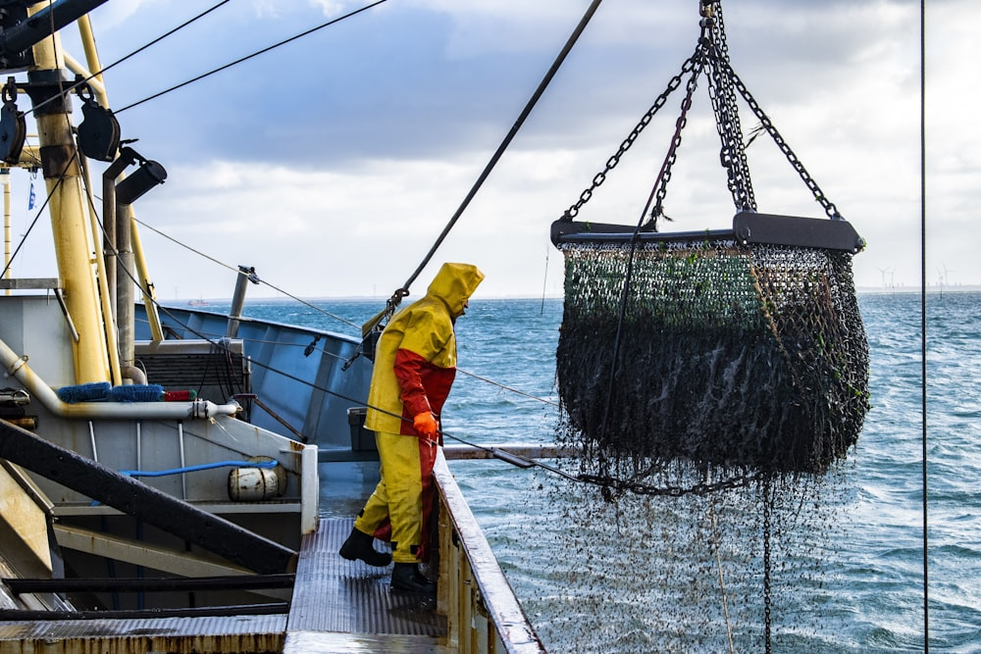

Evangelism is fishing where the fish are!
Notes:
Evangelism is fishing where the fish are. Where are the fish in your community? In the Pub – in the Gym – in their homes? Some are called to be deep sea fishermen – maybe to go abroad but most of us are called to local river fishmen. Make sure you have the right bait to attract the fish in your pond.
EXERCISE – Conduct a survey of the area around your church. Who lives there? Mainly elderly people? Mainly families? Young people? This should dictate your Churches evangelism strategy and should inform you on how best to reach the community. But also think about the non Christians you meet every day.

Slide 7



Which is why we need every member evangelism
Notes:
Because you have a whole net work of people around you we need every Christian to be an evangelist – see the next slide for a real life example -

Slide 8
LEAVE IT TO THE PRO’s?
Notes:
Lets just take a moment to pause and define exactly what we mean by Evangelism. The Bible simply defines it as spreading the good news. We can’t convert anyone but we can and should share Jesus with them. We plant the seed but God waters it and brings growth. Of course we back up everything with prayer. Here is my favorite definition of evangelism…. Next slide! (Add scripture reference here – ‘One plants, another sows, but God gives the increase’ – 1 Cor 3 v 6)

Slide 9
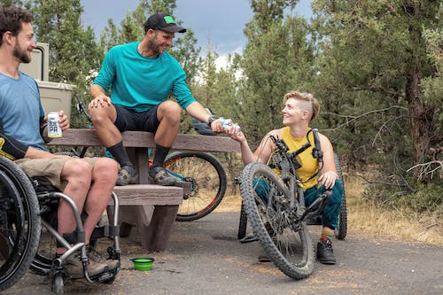



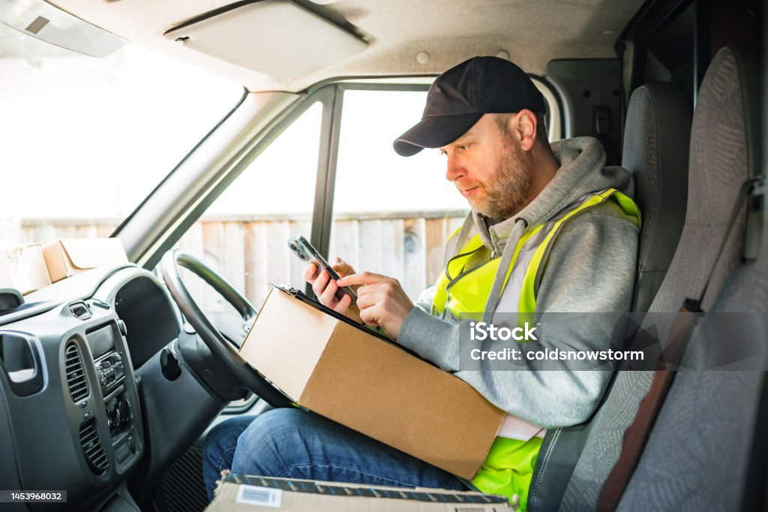
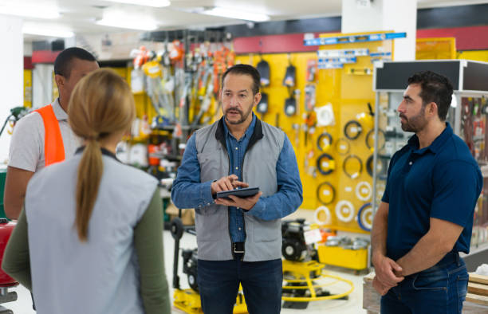
EACH CHRISTIAN MEETS PEOPLE
THE “PROS” WILL NEVER MEET!
Notes:
This is a Church in London where OUK Evangelist Andy Godfrey preached 3 weeks running on how every Christian can be an evangelist. One lady was in a wheel chair and on week 2 told Andy that she never meets Non-Christians so how can she be evangelist. During the conversation she told Andy that she has a carer come in every day. Andy asked if the carer was a Christian. The following week Vera, the lady in the wheel chair told Andy that she had given the Carer a Good News News paper and added “I’m an evangelist now”!!

Slide 10

Evangelism is NEVER DEFINED IN TERMS OF RESULTS!
Notes:
Something else we should note. Evangelism in the bible is never defined in terms of results. Remember the Angels rejoice over ONE sinner saved. Our job is just to preach, speak and live out the gospel.

Slide 11
DIFFERENT EVANGELISTIC STYLES ……
Notes:
Lets just take a moment to pause and define exactly what we mean by Evangelism. The Bible simply defines it as spreading the good news. We can’t convert anyone but we can and should share Jesus with them. We plant the seed but God waters it and brings growth. Of course we back up everything with prayer. Here is my favorite definition of evangelism…. Next slide! (Add scripture reference here – ‘One plants, another sows, but God gives the increase’ – 1 Cor 3 v 6)

Slide 12

Every Christian is needed.
EVERY CHRSITIAN SHOULD BE ASKING:
HOW CAN I USE MY –
TALENTS
MY GIFTS
MY ABLITIES
MY HOBBIES
- FOR THE SAKE OF THE GOSPEL?

Slide 13
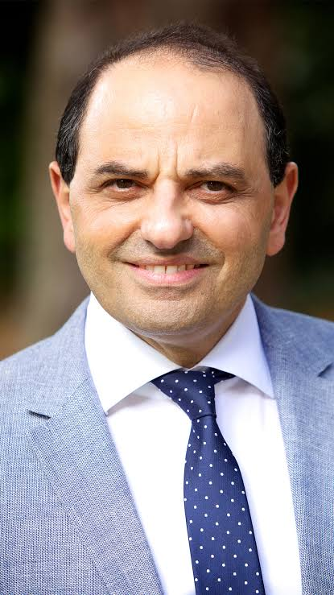


5 DIFFERENT TYPES OF EVANGELISM STYLES …
Notes:
Lets just take a moment to pause and define exactly what we mean by Evangelism. The Bible simply defines it as spreading the good news. We can’t convert anyone but we can and should share Jesus with them. We plant the seed but God waters it and brings growth. Of course we back up everything with prayer. Here is my favorite definition of evangelism…. Next slide! (Add scripture reference here – ‘One plants, another sows, but God gives the increase’ – 1 Cor 3 v 6)

Slide 14
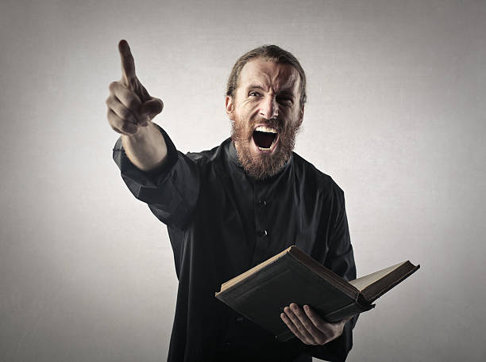
1. CONFRONTATIONAL
YOU!
Notes:
CONFRONTATIONAL – You may be a gifted speaker and be able to stand up and preach to large crowds. You may be the kind of person who is prepared to be confrontational with others. Perhaps you love to do open-air preaching and confront people with the gospel message. You share about sin, and then share the good news of the gospel – but in stark ways.
EXERCISE – Read Peters Sermon in Acts 2 and underline every time he uses the word YOU. You did this, you did that – you crucified Jesus. He is confronting people head on with their sin and their need of a Saviour and forgiveness. This is a legitimate form of evangelism.

Slide 15



2. INTELLECTUAL
Notes:
B. THE INTELLECTUTAL EVANGELIST. This might be someone who can sit down, with a non-Christian over a cup of Coffee and argue discuss the point for Christianity. Some one who can reason things out and is good at answering questions. A great place to start when someone asks you “why do you believe what you believe” is with the Resurrection. Someone, somewhere was the first person in the world to say that Jesus was alive. Ask the Non-Christian – why do you think they did that? The evidence for the resurrection is over whelming. There are many great books that will help you to explain the gospel.
(Perhaps we might like to make a few suggestions here)

Slide 16


3. Testimonial.
Notes:
C. THE TESTOMONIAL EVANGELIST. Every single Christian has two indispensable. One is their testimony. Remember that people love stories and no one can tell you that your story isn’t true. Remember that your testimony is not only about how you came to Christ. Its about what Christ has been doing for you since. Paul’s testimony as recorded in Acts 26 has a before, during and after element to it.

Slide 17

4. INVITATIONAL.
Notes:
D. THE FRIENDSHIP EVANGELIST. Here is the second tool that every Christian has – your home. It has been said that “If one person in the street is a Christian it should be good news for the whole street”. Why – because if you are known as a Christian – every one in the street knows which door to knock on when they need help, love, friendship, comfort – or even a cup of sugar! Invite non-Christians to your home for a meal, a coffee or to see a Christian Film. The challenge is this – do your neighbor's invite you to their homes when they are having a BBQ or a party? Not because they ought to but because you are such a great person. Jesus did not preach to Zacchaeus while he was in the tree – he went to his home!

Slide 18

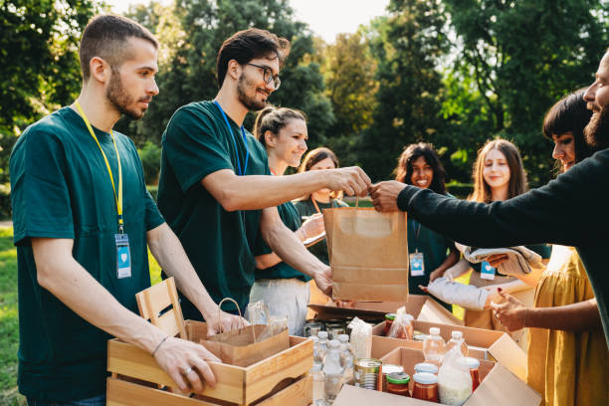
5. SERVICE
Notes:
D. THE SERVCIE EVANGELIST. Prime example – Dorcas in Acts 9. Why did Peter need to bring her back to life? Her work for the Lord was not yet done. She served others and thereby was an effective witness. Are you involved in your community? Do you have a hobby that brings you into contact with non-Christians? How can you be a witness for the Lord by helping others.?

Slide 19

1. The word of god
2. The holy spirit
3. Your story
4. Your home.
EVERY SINGLE CHRISTIAN HAS FOUR INDISPENSABLE TOOLS FOR EVANGELISM.
Notes:
C. THE TESTOMONIAL EVANGELIST. Every single Christian has two indispensable. One is their testimony. Remember that people love stories and no one can tell you that your story isn’t true. Remember that your testimony is not only about how you came to Christ. Its about what Christ has been doing for you since. Paul’s testimony as recorded in Acts 26 has a before, during and after element to it.

Slide 20



Confrontational
Intellectual
Service
Invitational
Testimonial
Notes:
5 different types of evangelist – which one are you and what excuse do any of us who know the Lord have not to be his “witnesses”?

Slide 21



we need - every member evangelism
Notes:
Because you have a whole net work of people around you we need every Christian to be an evangelist – see the next slide for a real life example -

Slide 22
FOR MORE INFORMATION AND
GOSPEL LITERATURE PLEASE CONTACT
www.outreachuk.com
info@outreachuk.com
0300 123 1990
www.goodnews-paper.org.uk
Mandy-goodnews@ntlworld.com
0115 9233324
www.ptluk.org
admin@ptluk.org
01903 705362
Notes:
Well done for completing this session.
Leader – For homework - this week, try and see how we might be able to use our listening skills to advance sharing the gospel – and be ready to share next time with our successes and, our struggles. We are all learning – and will keep learning as we refine our skills and God-given abilities and as He continues to teach and hone us.
Leader –
It’s a good idea to always have evangelistic literature available for your church members to use. We would recommend that you order Good News Newspapers each month and have a supply of PTL Gospels ready to be given away. Use the details on this slide to get in touch with Good News and PTL. If you want further help in evangelism training, Outreach UK have experienced evangelists available to help and support you – please get in touch using the details above.
Outreach UK has a team of Associate evangelists, each pledge to carry out 12 hours evangelism each month – in return, they get support, training and some free resources. If you or someone in your group is interested in knowing more about becoming an Outreach UK Associate Evangelist, please get in touch through the details on the slide, we’d love to hear from you.
May you know God’s blessing and encouragement as you reach out with the gospel.
End with prayer.

Slide 23
FOR MORE INFORMATION AND
GOSPEL LITERATURE PLEASE CONTACT:
www.outreachuk.com
info@outreachuk.com
0300 123 1990
Notes:
End of session on becoming the evangelist you were meant to be– well done. We hope you’ll pray for an opportunity to share your story between now and the next session.
Leader -
Possible homework – write out your testimony and share it with a Christian and with a non-Christian.
(Give opportunity next time you meet to discuss how people got on with this. Don’t be hard on those who struggled, but always encourage them to pray for an opportunity this coming week.)
Leader –
It’s a good idea to always have evangelistic literature available for your Church Members to use. We would recommend that you order Good News Newspapers each month and have a supply of PTL Gospels ready to be given away. Use the details on this slide to get in touch with Good News and PTL. If you want further help in evangelism training, Outreach UK have experienced evangelists available to help and support you – please get in touch using the details above.
Outreach UK has a team of Associate evangelists, each pledge to carry out 12 hours evangelism each month – in return, they get support, training and some free resources. If you or someone in your group is interested in knowing more about becoming an Outreach UK Associate Evangelist, please get in touch through the details on the slide, we’d love to hear from you.
May you know God’s blessing and encouragement as you reach out with the gospel.
End with Prayer.

